Slide 1


Cogwheel Platform (Spin Unit)
Web address, email-contact
The technical development in the genomics area has been overwhelming in recent years and the next generation sequencing instruments now allow large-scale genomics on a previously unattainable scale. The next-generation DNA sequencing techniques can be used for a variety of studies: whole genome resequencing, complete exome sequencing (all exonic sequences), de novo sequencing, targeted sequencing of regions in single or multiple individuals.
Modern genome analyses critically depend on expertise in computational biology (e.g. bioinformatics, biostatistics, and theoretical systems biology).
Tjänst 1 (Beskrivande namn)
Tjänst 2 (Beskrivande namn)
Tjänst 3 (Beskrivande namn)
Tjänst 4 (Beskrivande namn)

Slide 2
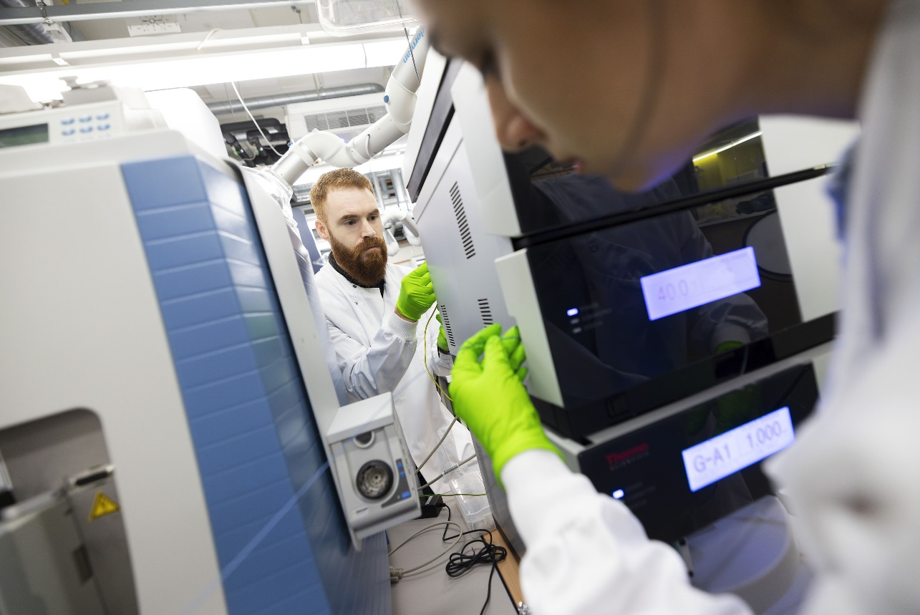
SciLifeLab Infrastructure organization
Platforms and Units
Bioinformatics
Cellular and Molecular Imaging
• Support, Infrastructure and Training G, Li, Lu, S, U, Um
• Support for Computational Resources U
• BioImage Informatics U, S
• AIDA Data Hub Li
• Integrated Microscopy Technologies S, G, Um
• Cryo-EM S, Um, G, Lu, U
Integrated Structural Biology
Genomics
• Swedish NMR Centre G, Um
• Structural Proteomics Lu
• Cryo-EM S, Um, G, Lu, U
• National Genomics Infrastructure S, U
• Ancient DNA S, U
Chemical Biology and Genome Engineering
Clinical Genomics
• Chemical Biology Consortium Sweden S, Um, Li, Lu, G, U
• Chemical Proteomics S
• CRISPR Functional Genomics S
• Clinical Genomics G, Li, Lu, S, Um, U, Ö
Metabolomics
Drug Discovery and Development
• Swedish Metabolomics Centre Um
• Chalmers Mass Spectrometry Infrastructure G
• Exposomics S
• ADME (Absorption, Distribution, Metabolism, Excretion) of Therapeutics U
• Biochemical and Cellular Assay S
• Biophysical Screening and Characterization U
• Display and Selection Lu, S
• Medicinal Chemistry – Hit2Lead S
• Medicinal Chemistry – Lead Identification U
• OligoNova Hub G
• Target Product Profiling and Drug Safety Assessment S, U
• Target Protein Engineering S
Clinical Proteomics and Immunology
• Autoimmunity and Serology Profiling S
• Affinity Proteomics S, U
• Global Proteomics and Proteogenomics S
• Glycoproteomics and MS Proteomics G
Spatial Biology
• Spatial Proteomics S
• In Situ Sequencing S
• Spatial Mass Spectrometry U
• Spatial Transcriptomics S
G – Gothenburg
Li -Linköping
Lu – Lund
S -Stockholm
U -Uppsala
Um -Umeå
Ö – Örebro

