Slide 1
Towards an interpretable deep learning model of cancer cells
25th of April 2025
SciLifeLab AI Seminar Series
Online
Avlant Nilsson
Assistant Professor, DDLS fellow
SciLifeLab, Department of Cell and Molecular Biology
Karolinska Institutet
avlant.nilsson@ki.se
Notes:
At the department of Cell and Molecular Biology at KI.
We are located at the SciLifeLab building in Solna, in Alpha 2
I would like to thank the organizers, for the invitation to talk at SciLifeLabs AI seminar series
And I am particularly excited about the opportunity to talk more about the theoretical and technical details related to our labs work…

Slide 2

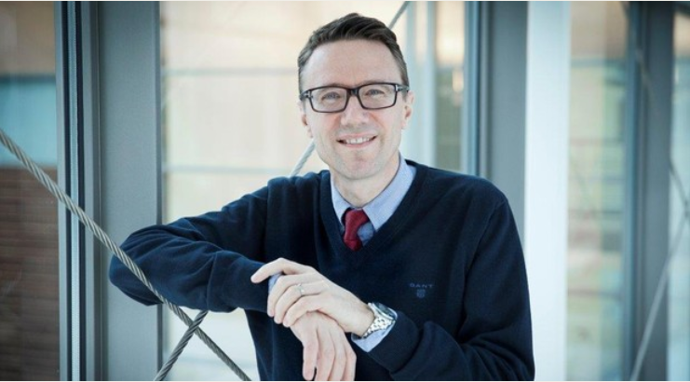
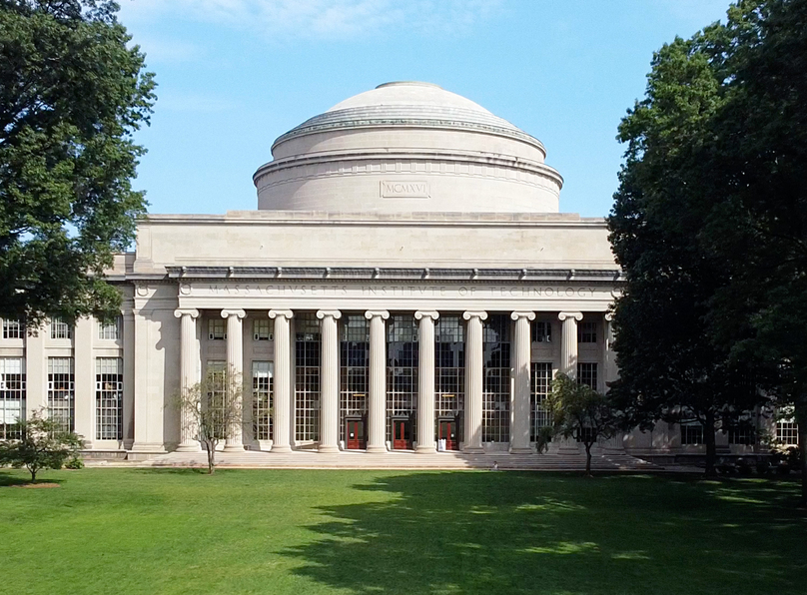

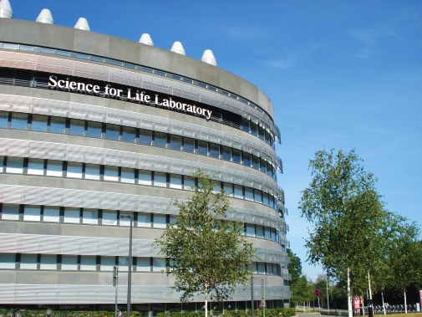
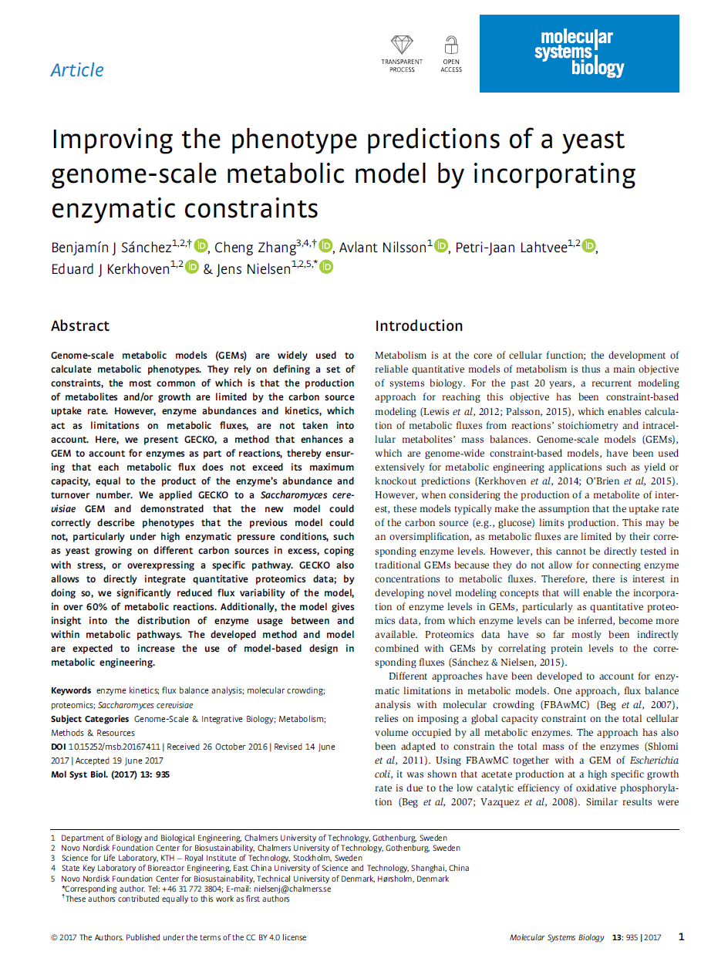
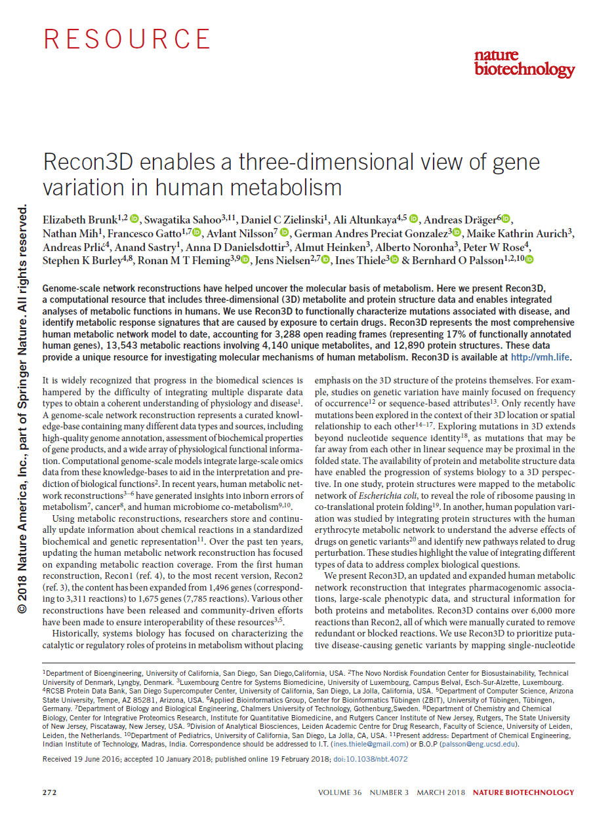
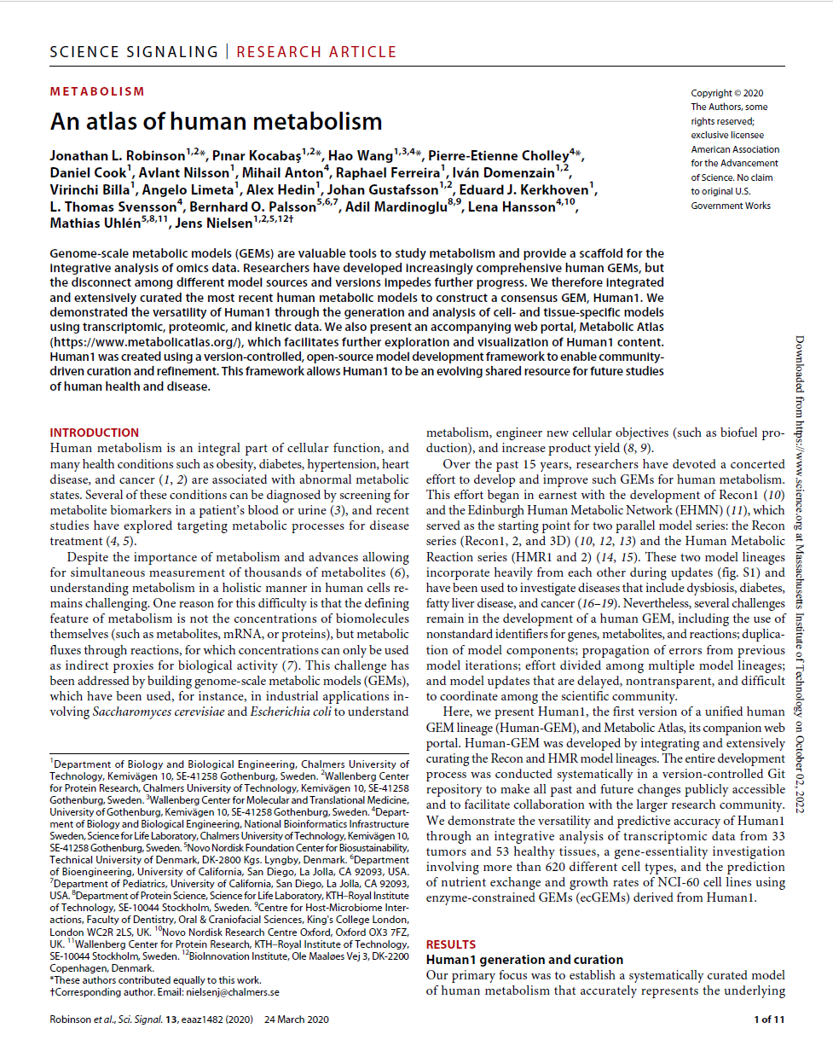

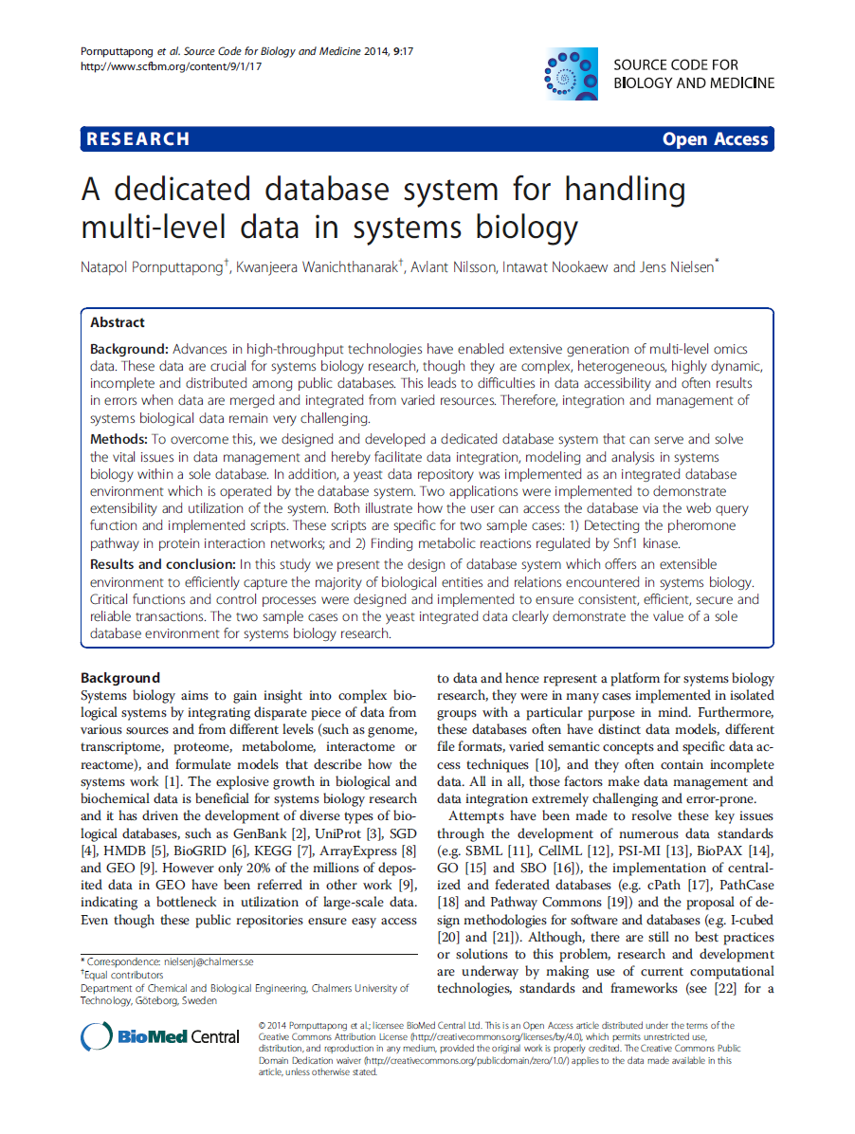
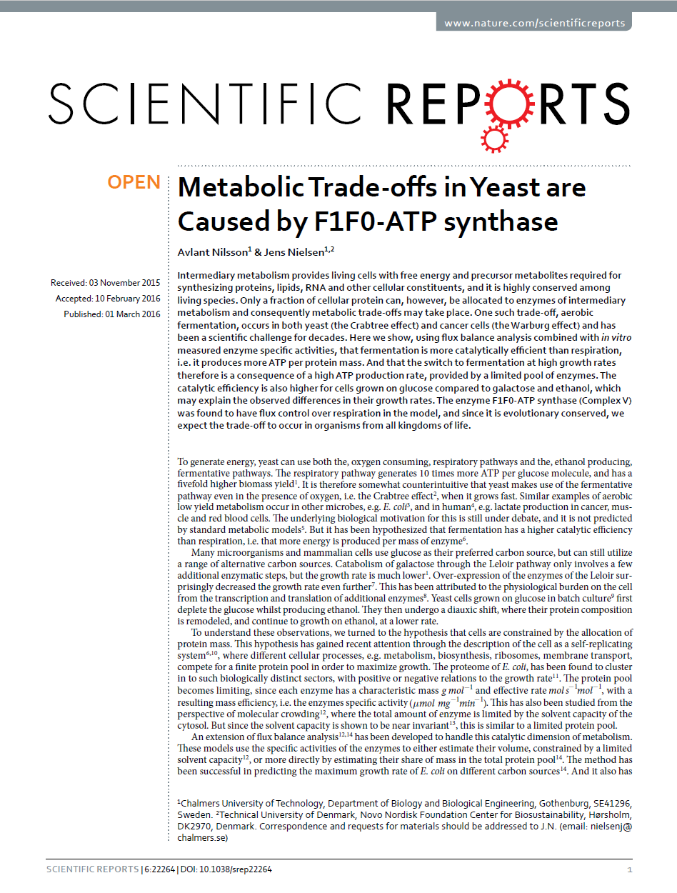
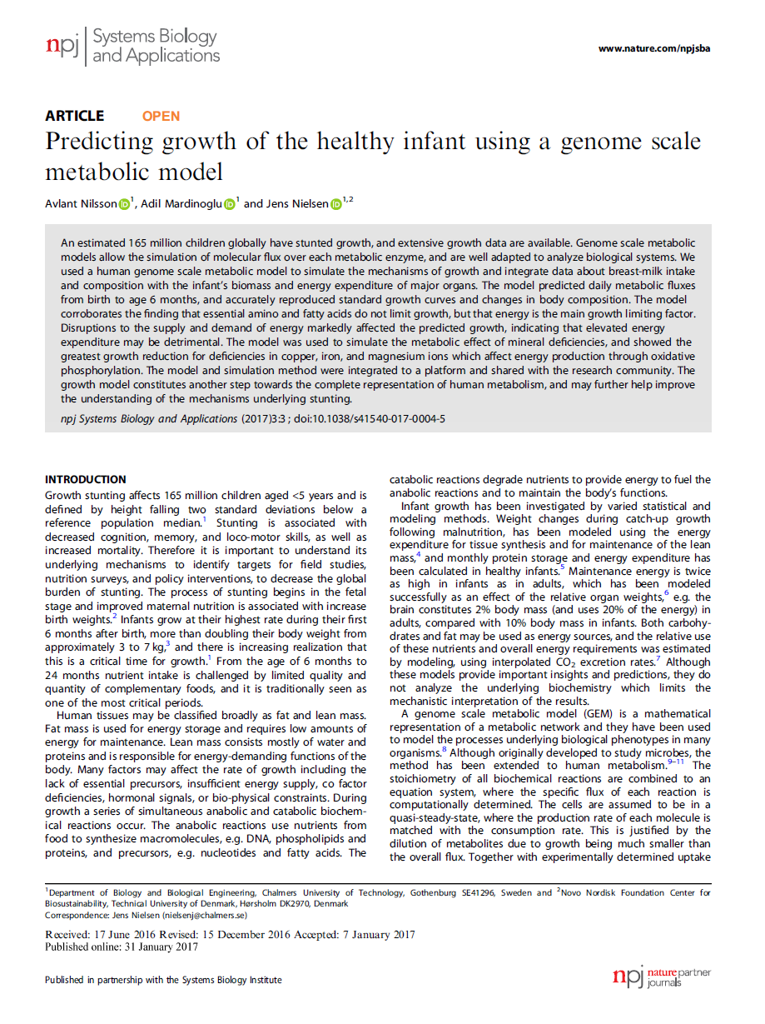
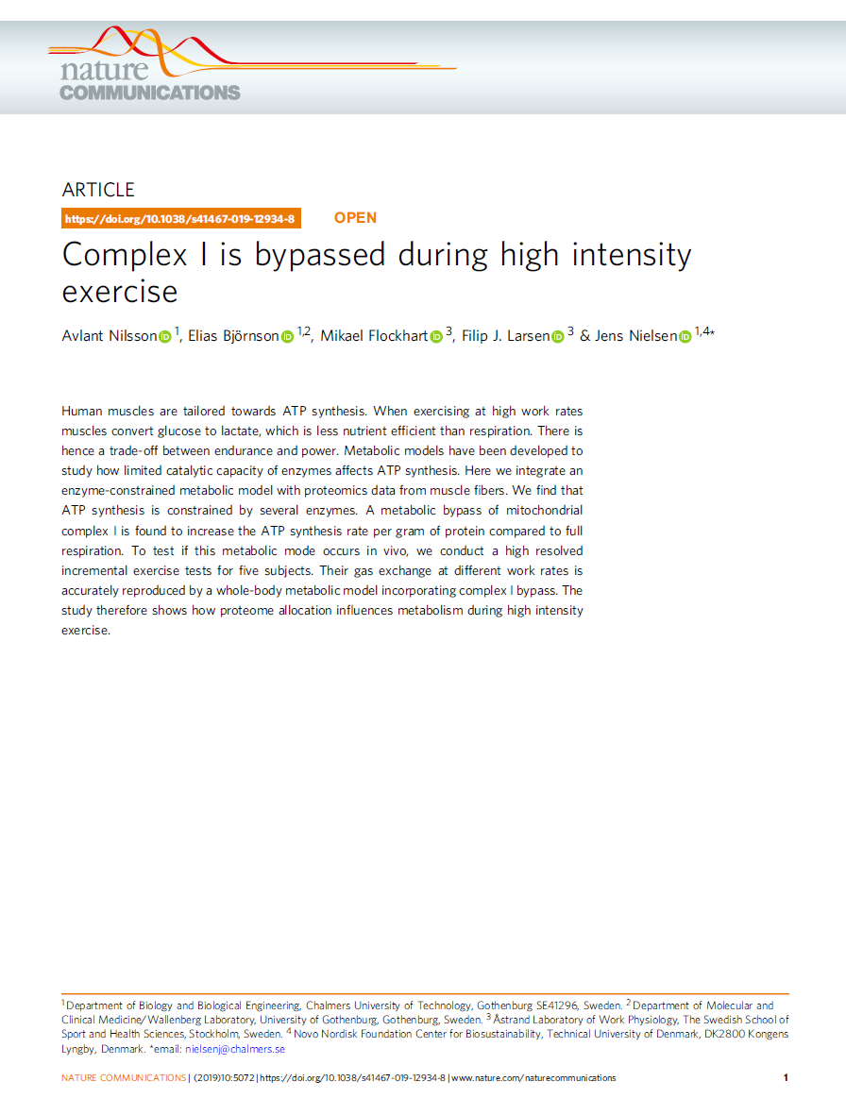
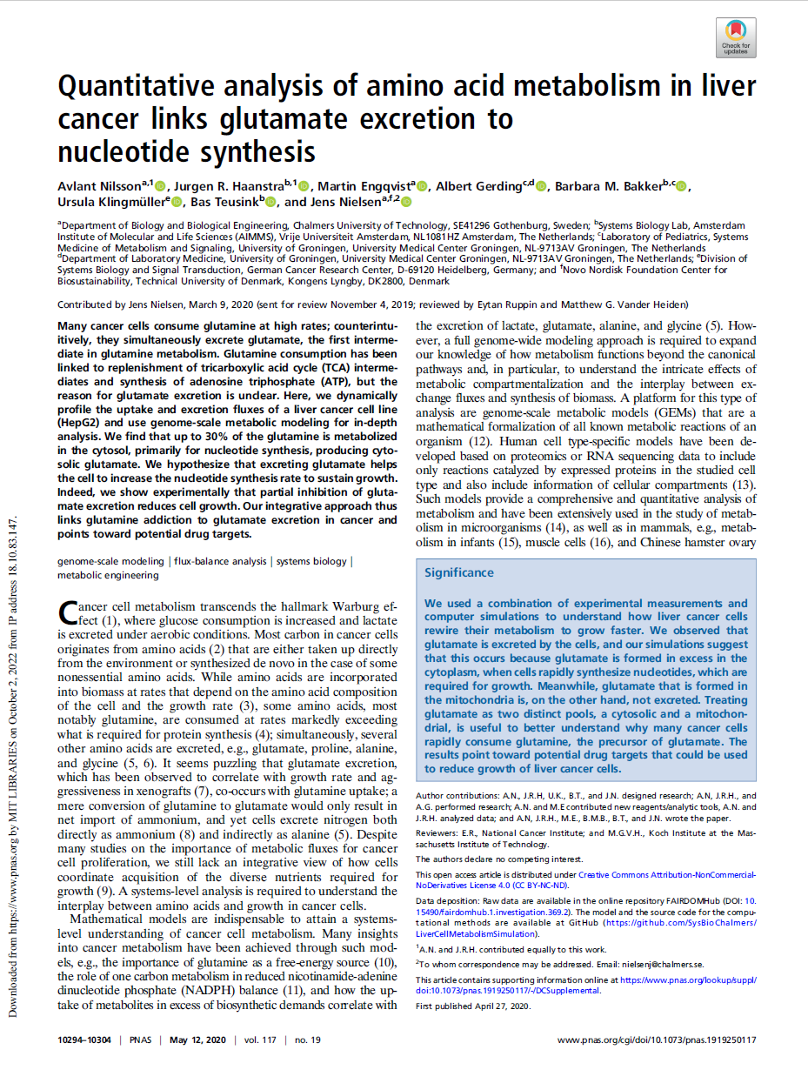
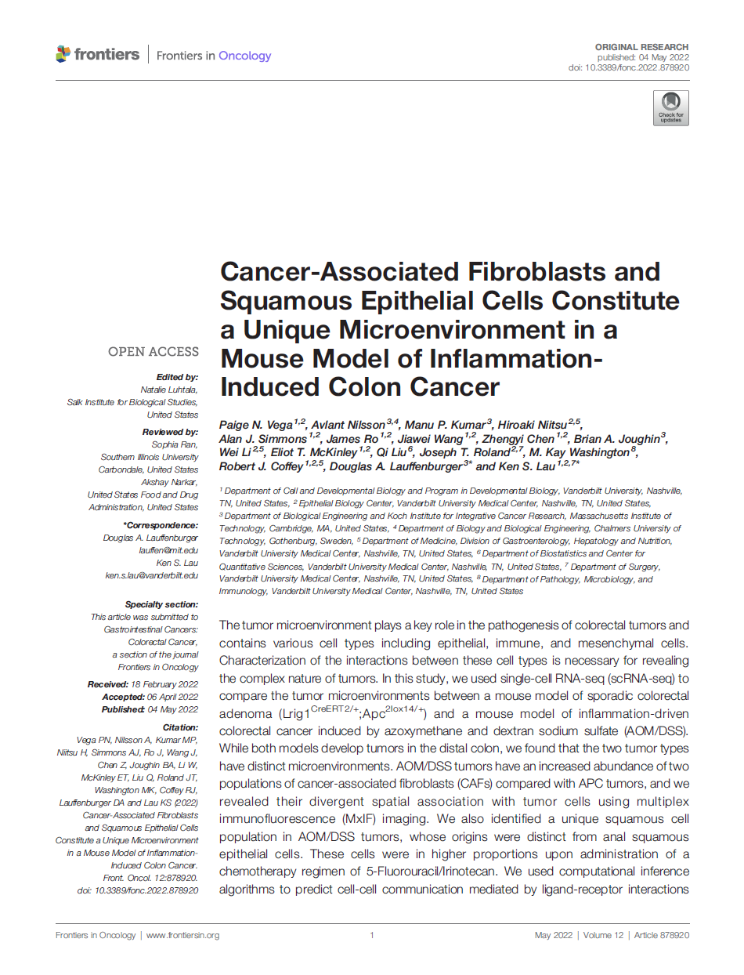
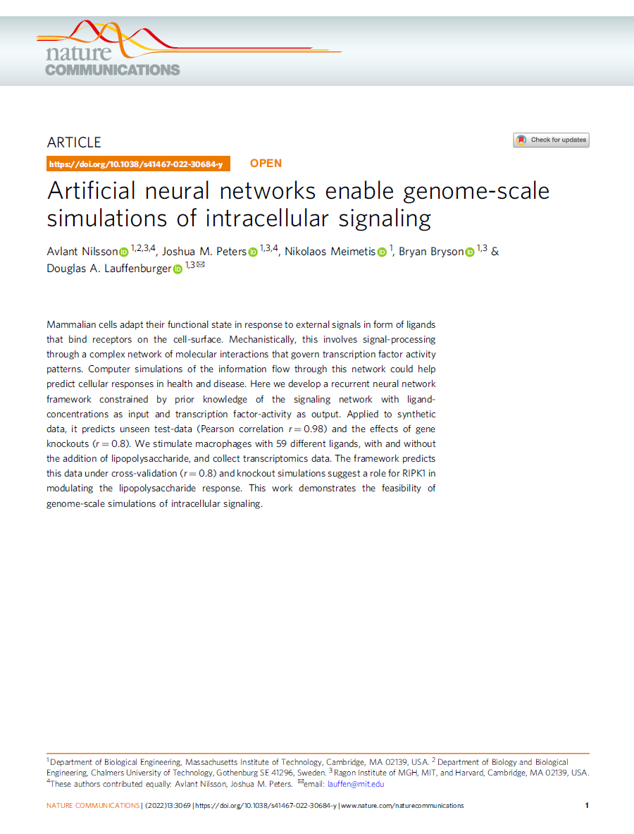
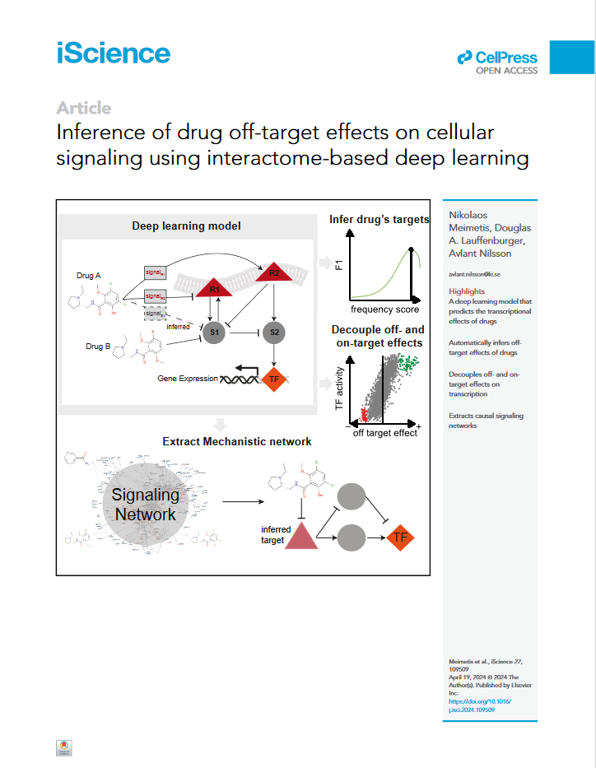
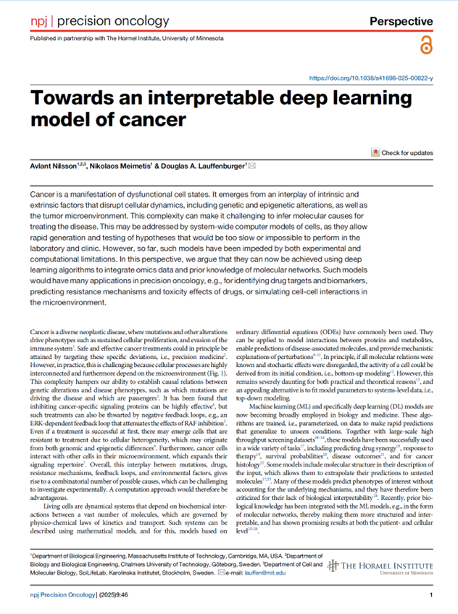
My Background
Jens Nielsen
Doug Lauffenburger
BSc
MSc
PhD
VR
DDLS
AGC
2012
2014
2016
2018
2020
2022
2024

Slide 3
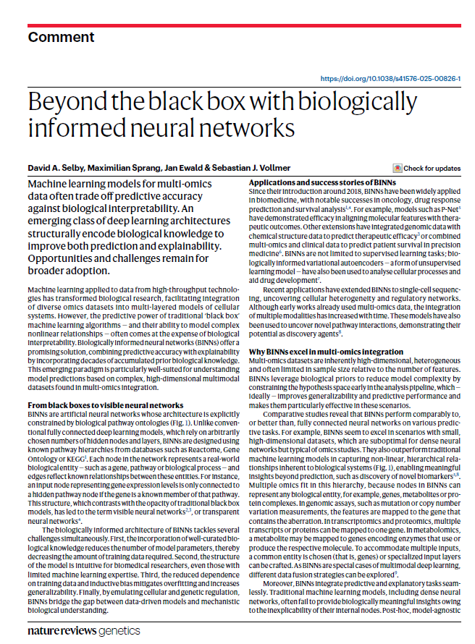
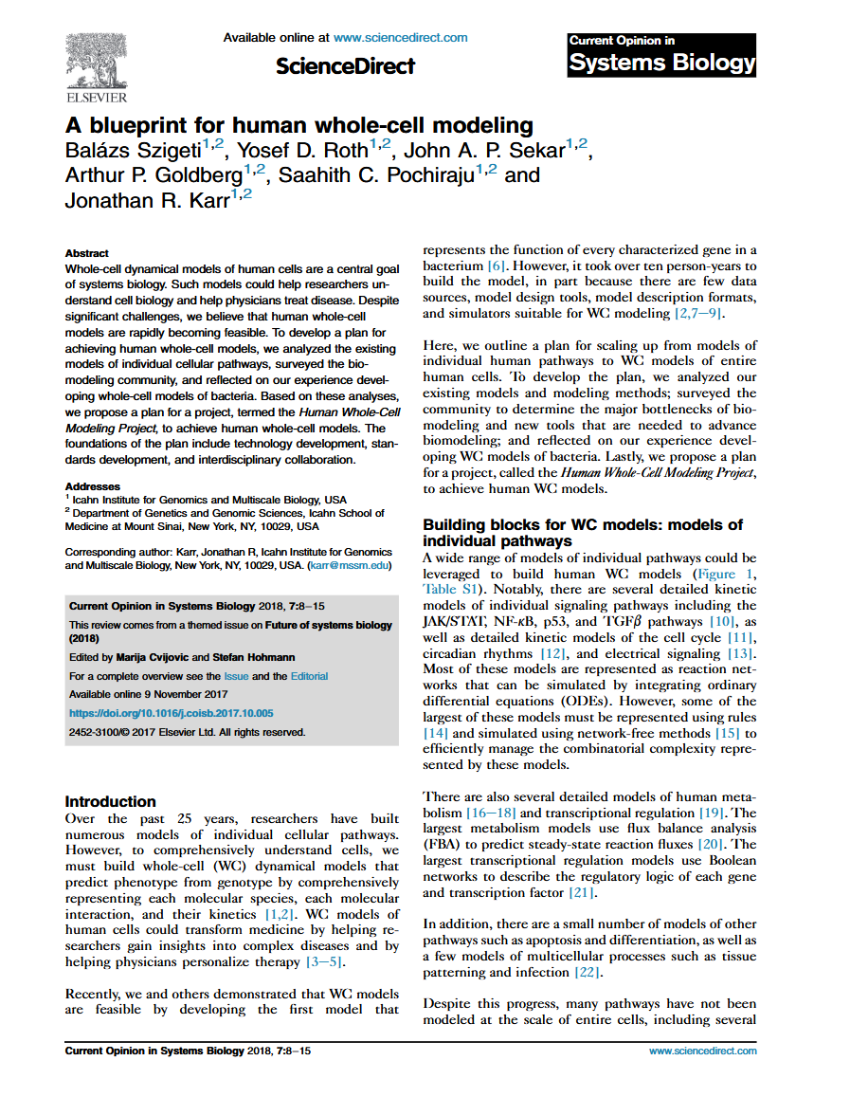
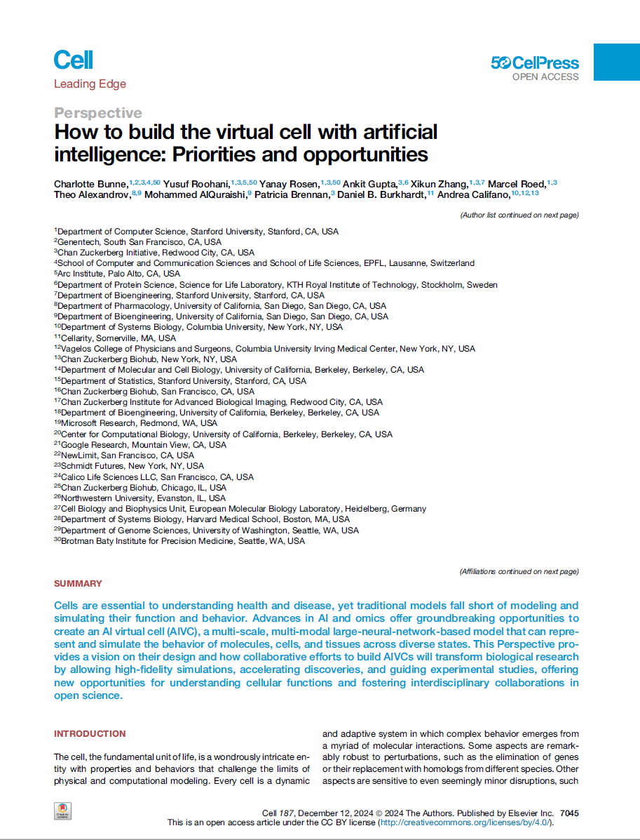
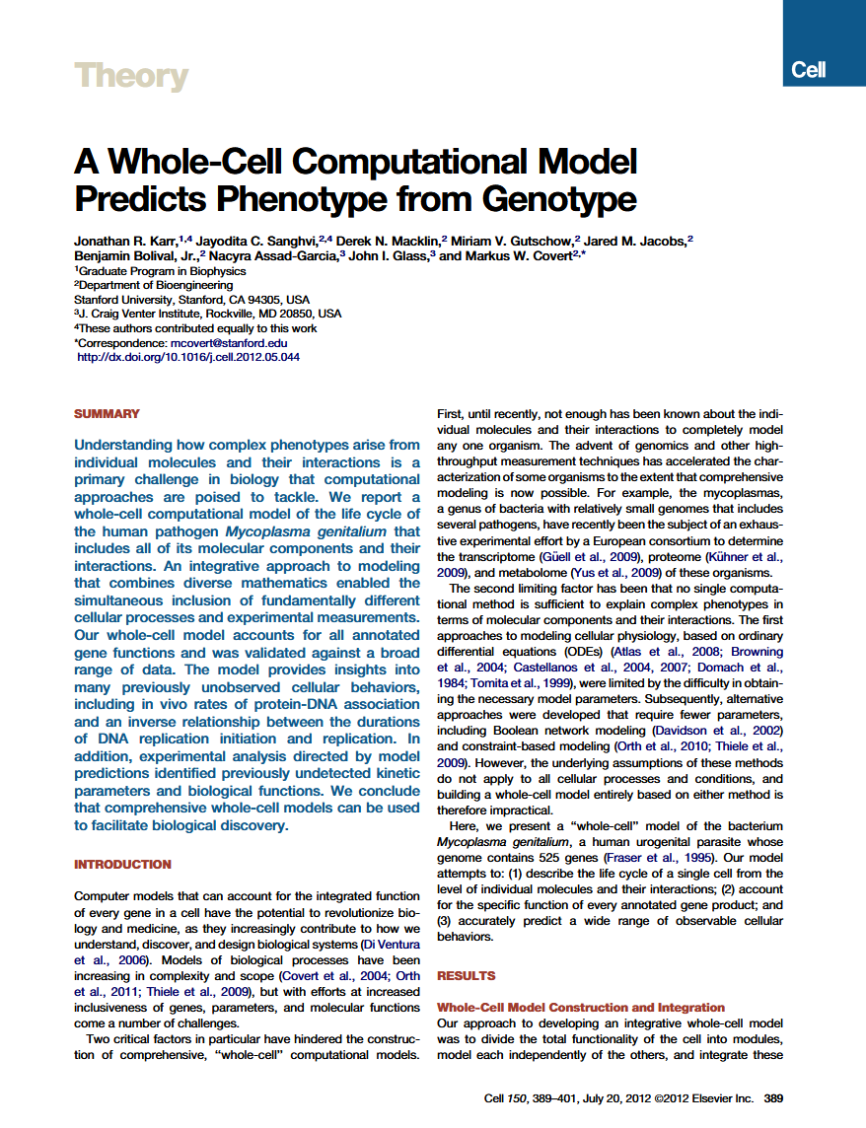
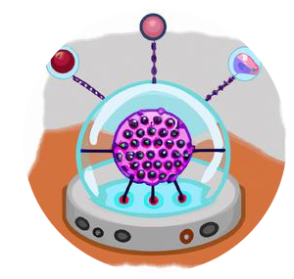
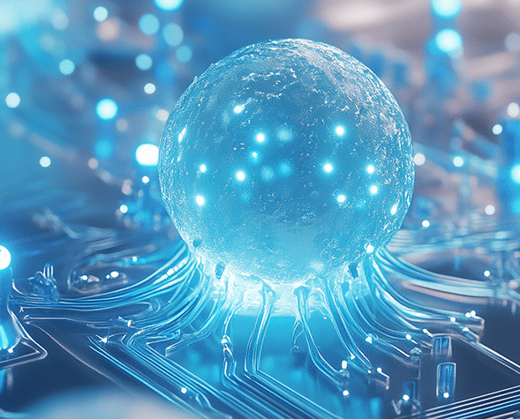
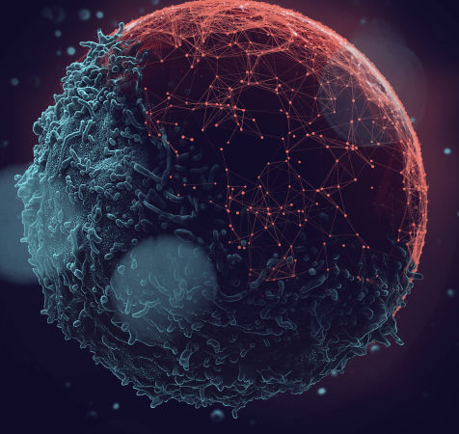

Towards AGC: an Artificial Generic Cell
2025
2025
2018
Dec 2024
2013
Pre-AI
AICell Lab
AlphaCell
Notes:
The idea of AGC, an artificial generic cell in the computer predates AI
With the first functional model of a micro-organism using a wide mixture of different modeling techniques integrated into a single computer program
There was also a roadmap for applying these ideas to model human cells, but it turned out to be rather challenging.
The AI revolution in computer science has transformed what is possible in terms of large-scale modeling, and there is renewed interest in these ideas
Only over the last half year there has been several opinion pieces in high impact journals drawing out, slightly different, roadmaps towards this
Some focusing on molecular embeddings, and others (including our paper) on incorporating molecular networks
There are also companies working on this, and locally we have Wei’s AICell Lab working on imaging of cells to train a generative model and there is also the 200 million AlphaCell initiative that will be starting here at SciLifeLab.

Slide 4

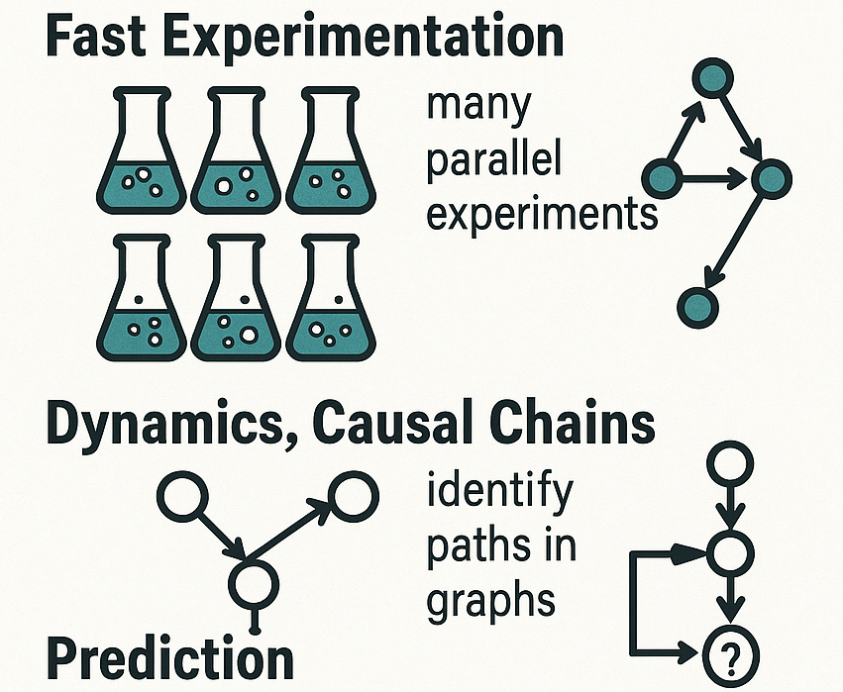
Why AGC?
Fast experimentation
Dynamics, causal chains
Prediction
Chat-GPT generated artwork
AGC = Artificial Generic Cells
Notes:
What is the use case for an artificial cell?
Generally, the benefit of computer modeling is fast experimentation, in inference mode you can easily do millions of experiments in short period of time.
Unlike data, which is a snapshot of the cell, in a particular state, a dynamic model may allow you to follow the propagation of molecular causes to phenotypes
And arguably most importantly for cancer, you may be able to predict the effects of previously unseen combinations of mutations

Slide 5
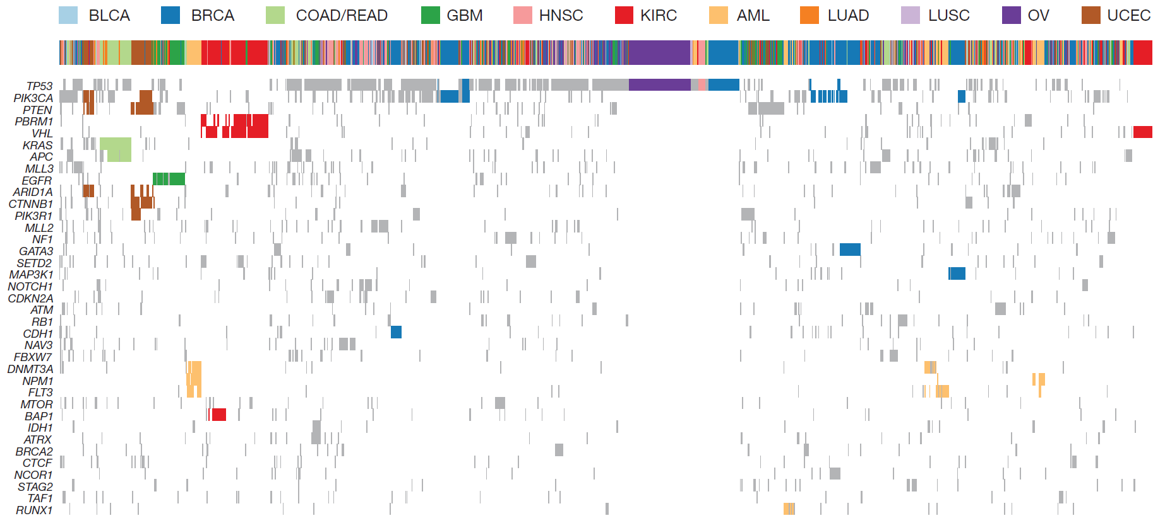
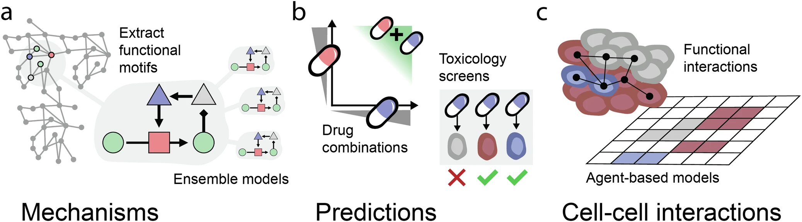
Every cancer is unique
Which alterations are driving the cancer?
Mutated genes
How can the cancer develop resistance?
…
3000+ Tumors
Kandoth, C. et al (2013). Mutational landscape and significance across 12 major cancer types. Nature 2013 502:7471, 502(7471), 333–339.
Notes:
Specifically for cancer
Cancer emerges from complex molecular interactions that drive pathological cells states.

Slide 6
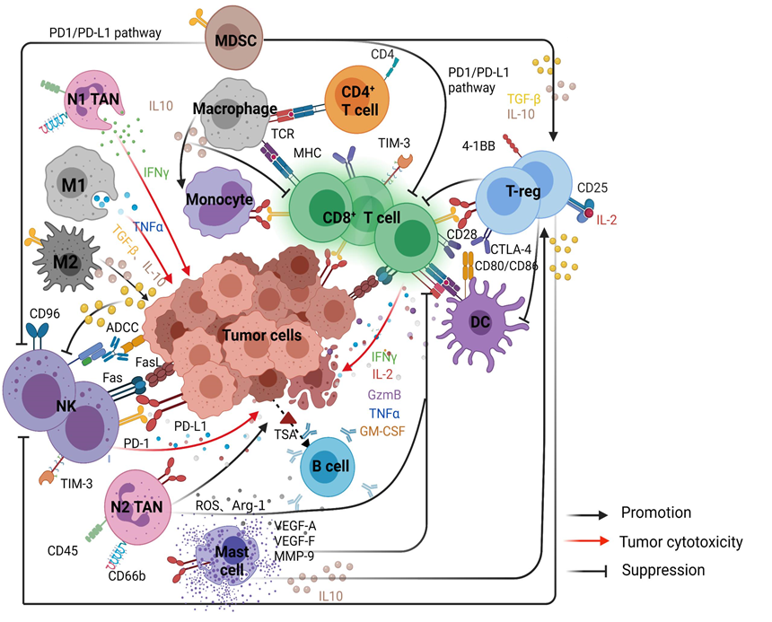

Cancers interact with other cells
Could elucidate cell-cell interactions
Li, X. et al. Crosstalk Between the Tumor Microenvironment and Cancer Cells: A Promising Predictive Biomarker for Immune Checkpoint Inhibitors. Frontiers in Cell and Developmental Biology vol. 9 (2021).
Notes:
Single cell technologies has started to reveal the full complexity of cell-cell interactions in cancer
There are now very advanced culture system where we can grow many cell types together
However, it would be amazing if we could instead simulate these interactions directly in the computer.

Slide 7
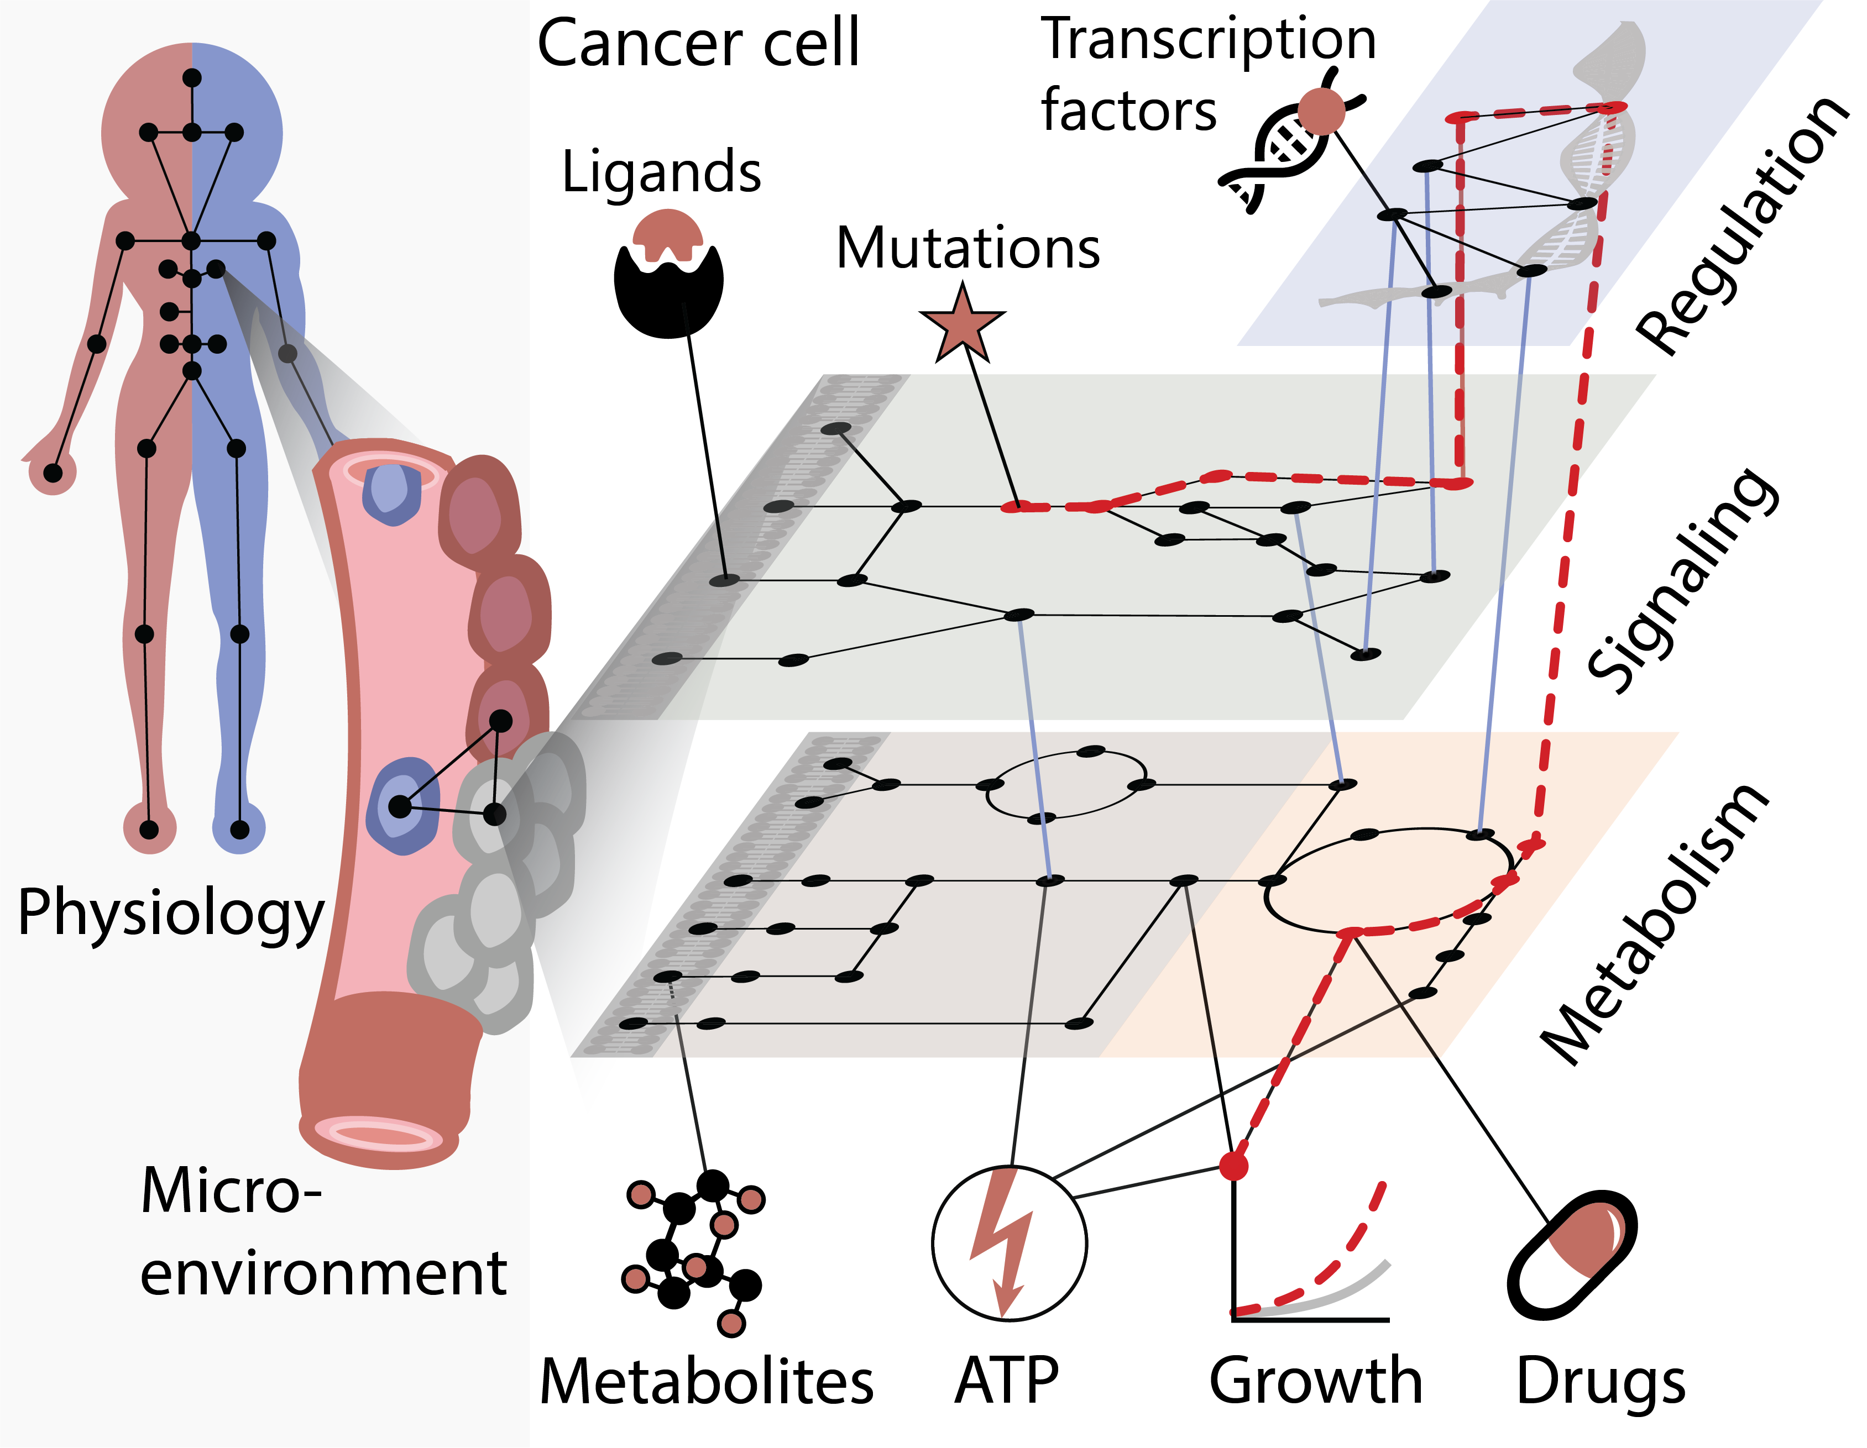
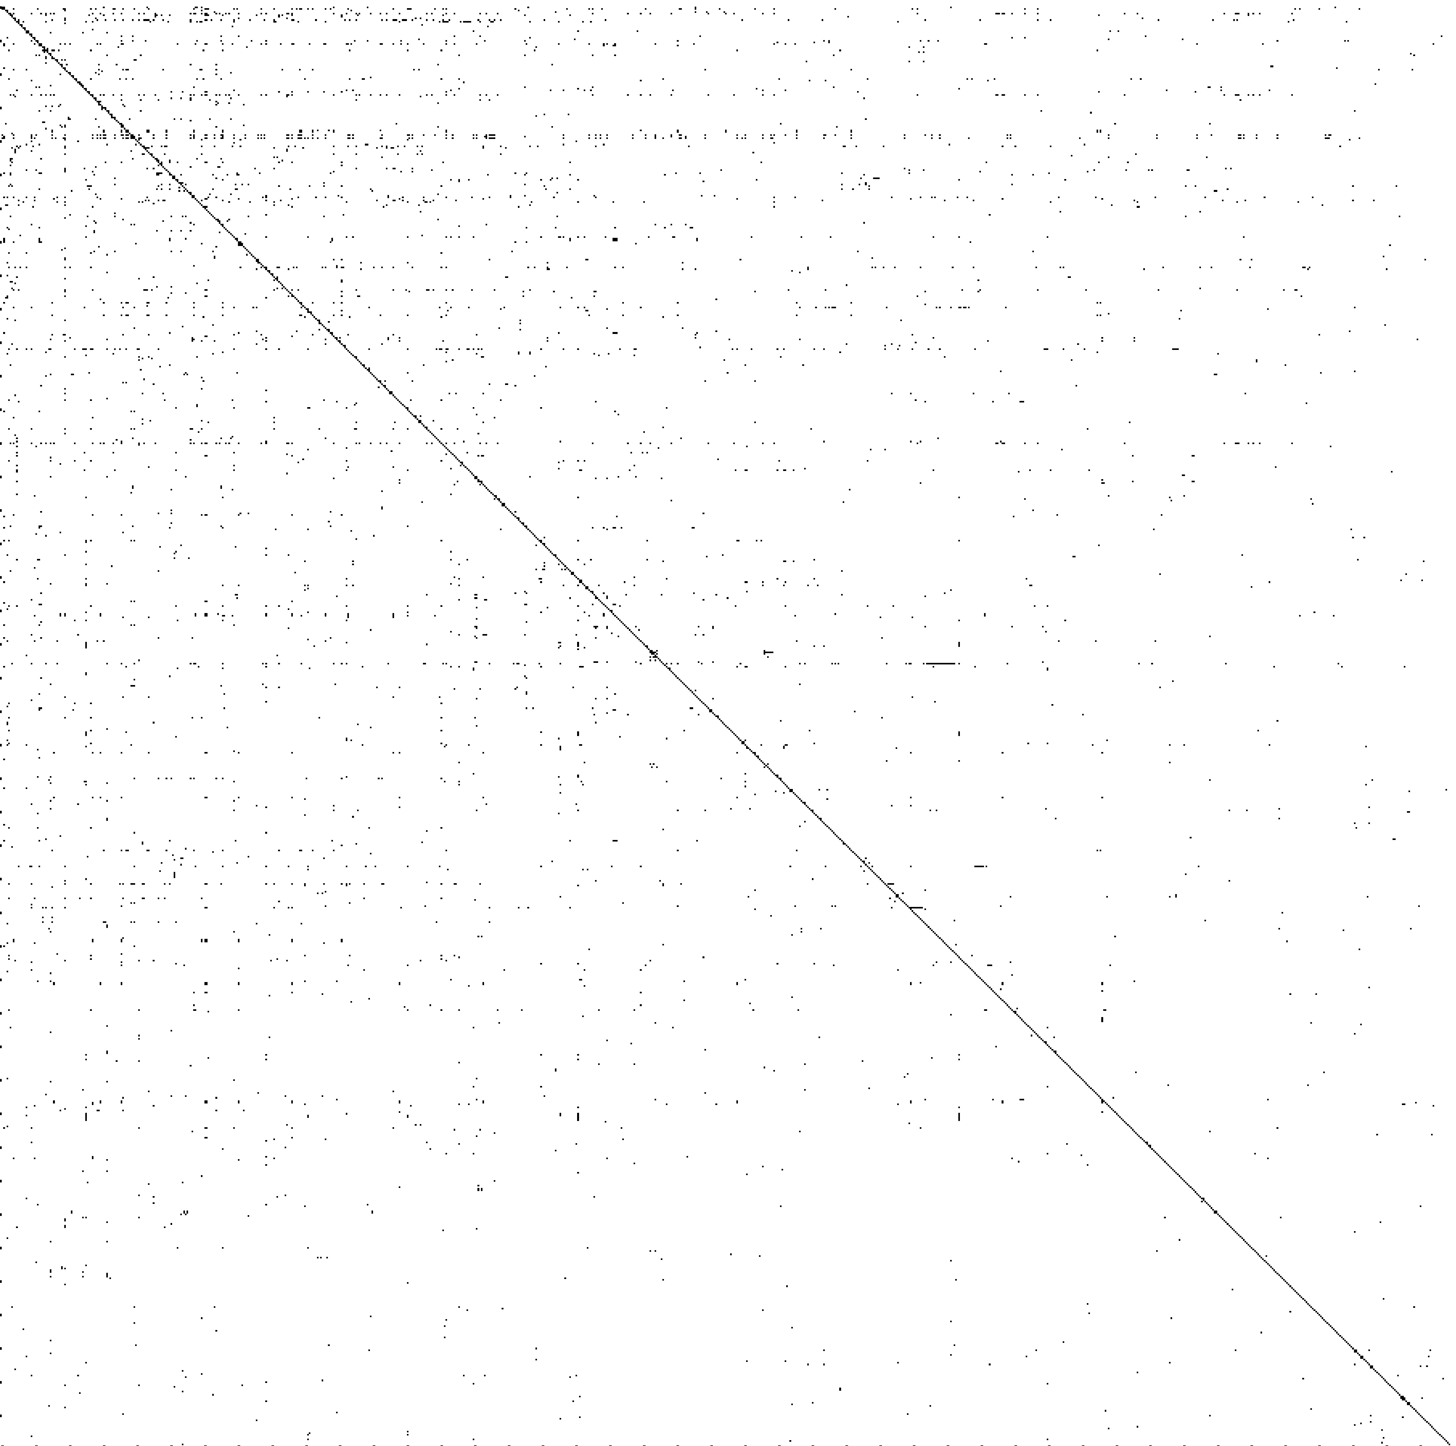
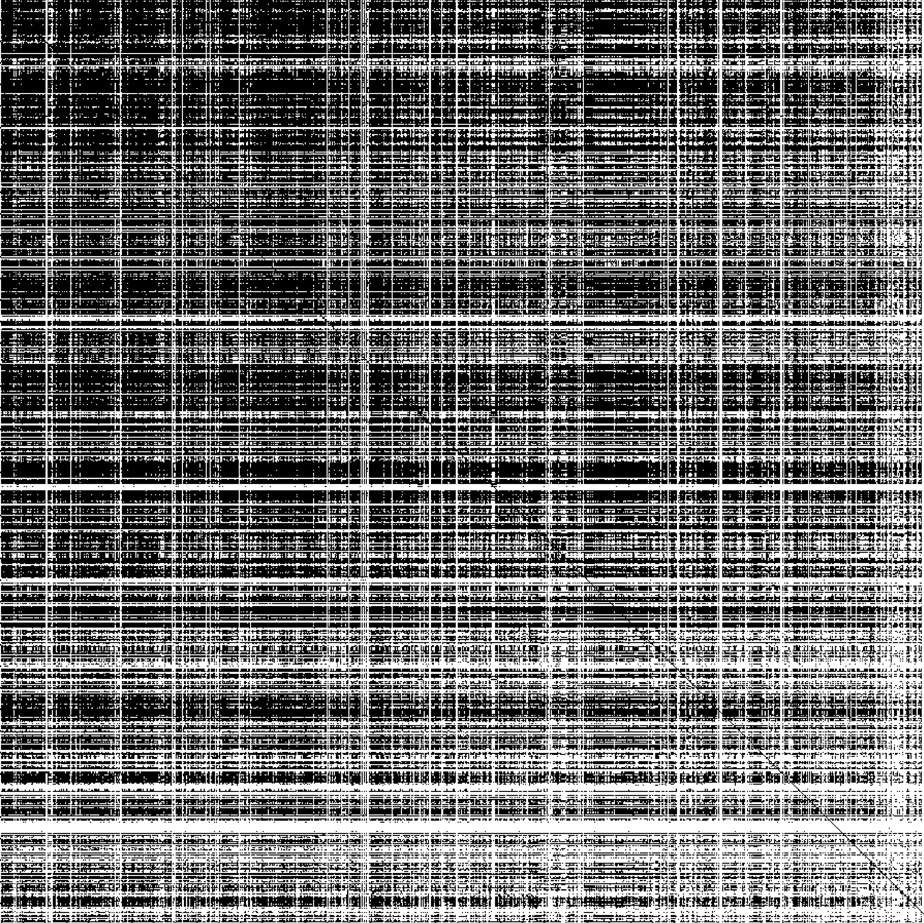
Network-based approach
Interpretable by construction
Straight-forward mapping of data
Reduced data requirements
Direct interactions
Interactions within 5 steps
Signaling protein
Signaling protein
1000 protein signaling network from OmniPath

Slide 8
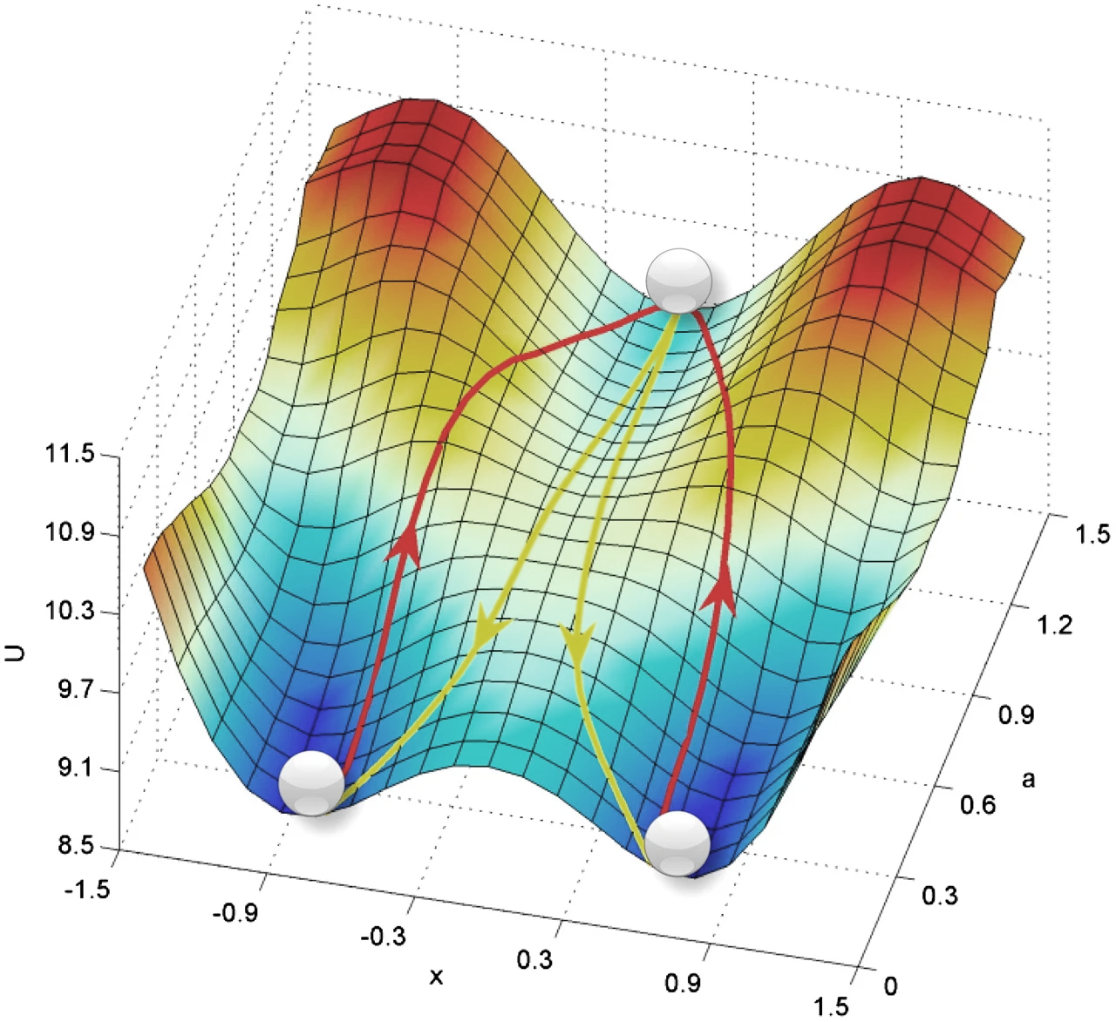

Generic model: cell types/cancers are cell states
A: each cell type/cancer - one model
What differentiates cells is (primarily) the molecular quantitates.
B: one model for all cells
0
I
II
Wang, J. et al (2011). Quantifying the Waddington landscape and biological paths for development and differentiation. Proceedings of the National Academy of Sciences of the United States of America, 108(20), 8257–8262.
Notes:
While mutations can change the effects of a molecule.
It is often the downs steam consequences that carry out the effects (EGFR) and at the molecular level they are no different from the healthy case

Slide 9
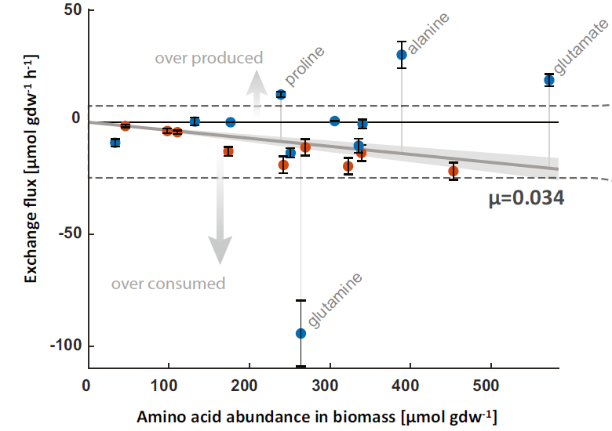

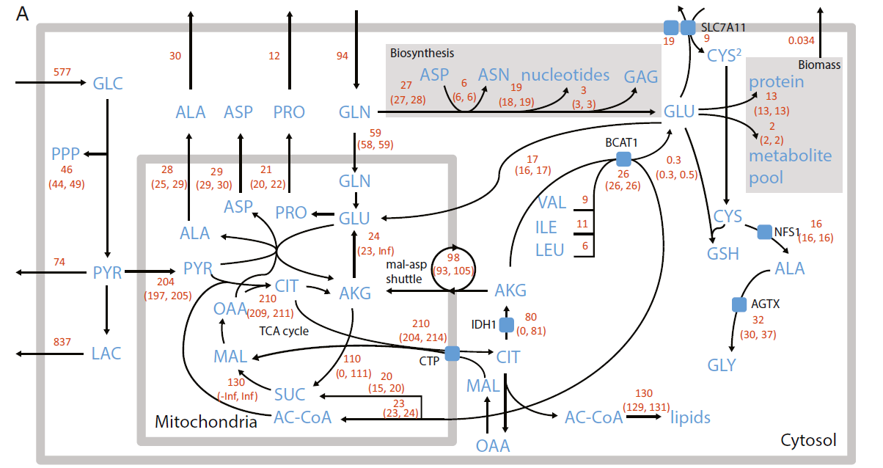
Causes and effects transcend sub-networks
Causes
Kandoth, C. et al (2013). Mutational landscape and significance across 12 major cancer types. Nature 2013 502:7471, 502(7471), 333–339.
1000s of interactions
Effectors
1000s of reactions
Nilsson, A. et al. “Quantitative Analysis of Amino Acid Metabolism in Liver Cancer Links Glutamate Excretion to Nucleotide Synthesis.” Proceedings of the National Academy of Sciences 117, no. 19 (2020): 10294–304.
Notes:
[slide was omitted from presentation]

Slide 10
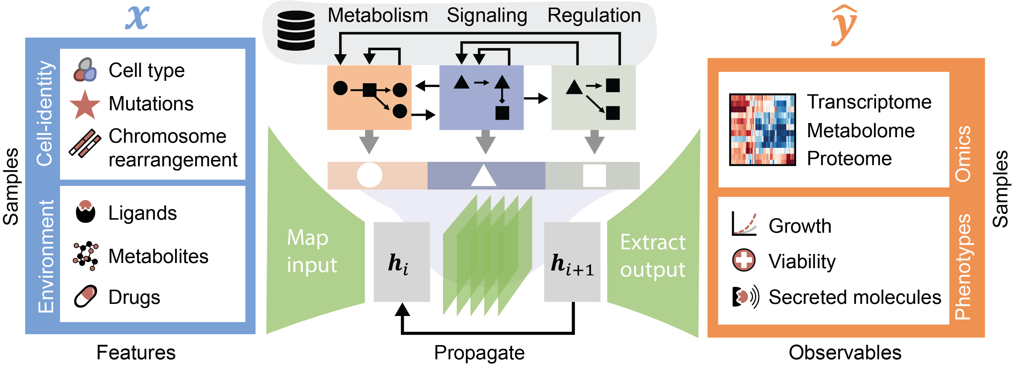
An interpretable deep learning model of the cell
Molecular causes
Cellular networks
Effects
Notes:
To enable this, we are developing an interpretable deep learning model of the cell.
It takes molecular causes as input (such as the cell type, mutations, ligands and drugs) and outputs their effects on phenotypes and different omics measures.
Between input and output, we don’t have a black box architecture such as a feed forward network, convolutions, or transformer,
we are instead developing an architecture based on the molecular networks of the cell,
so that every prediction the model makes can be traced back to known physical interactions.
Some of the longer time-scale feedback loops have not yet been implemented.

Slide 11
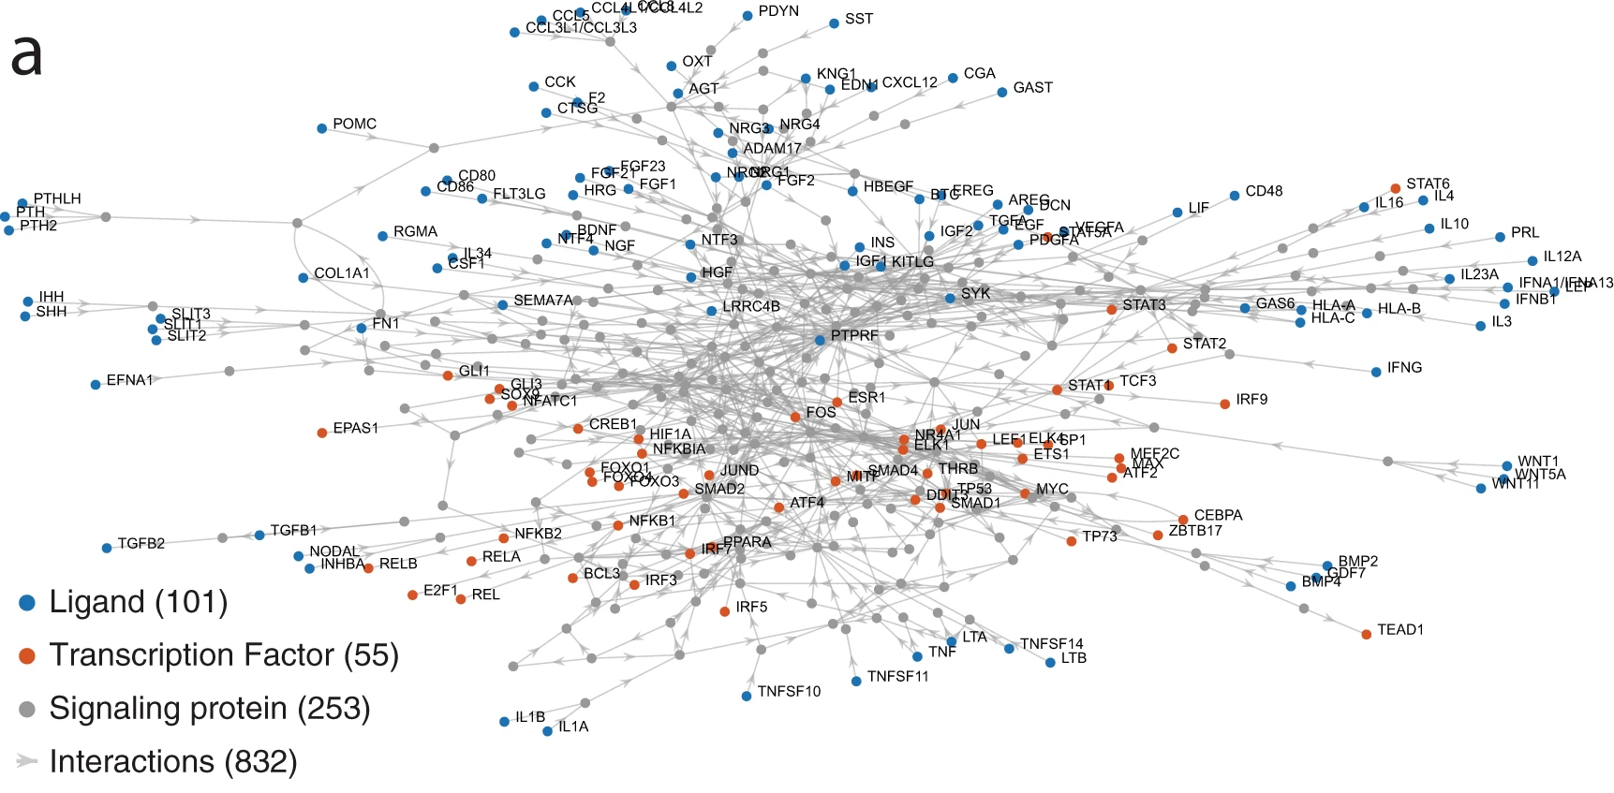

Network: effects caused by many local interactions
A
B
Input
X
State
Nilsson, A, et al “Artificial Neural Networks Enable Genome-Scale Simulations of Intracellular Signaling.” Nature Communications 13, no. 1 (2022): 3069.
Karolinska Institutet - a medical university

Slide 12

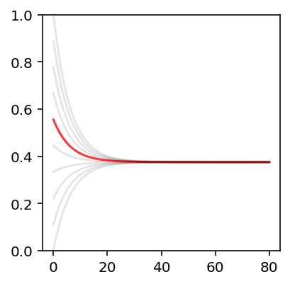
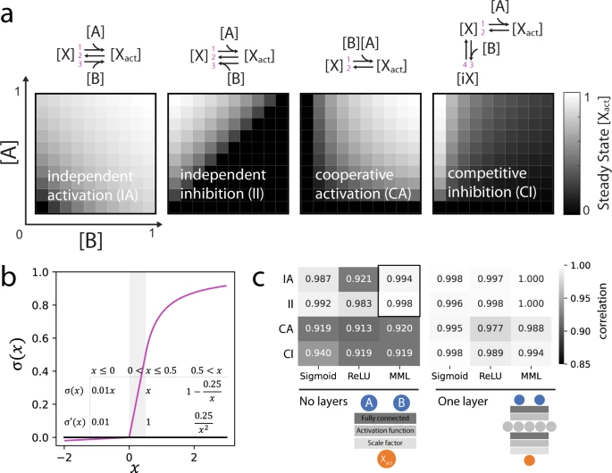

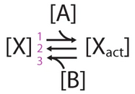
Local steady states
Independent of initial activity of X
Input-output relations
A
B
Input
Kinase
X
State
Activity (ratio)
Steady state
Phosphatase
Time
Rate constants
Activity of X for fixed activities of a kinase (A) and phosphatase (B)
Karolinska Institutet - a medical university

Slide 13



The challenge: 1000s unique functions
The functional form is mostly unknown
n
1 unique function for each signaling molecule
$$h_{i}$$
$$h_{i+1}$$

Slide 14
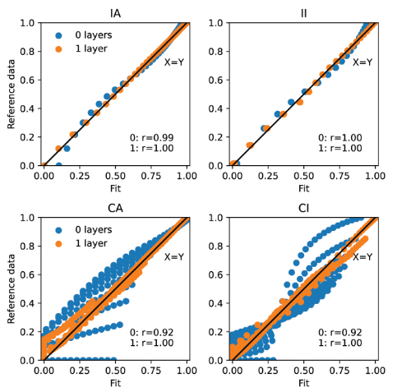
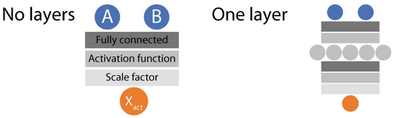
Approximation of unknown functions
Michaelis–Menten like activation function

Slide 15
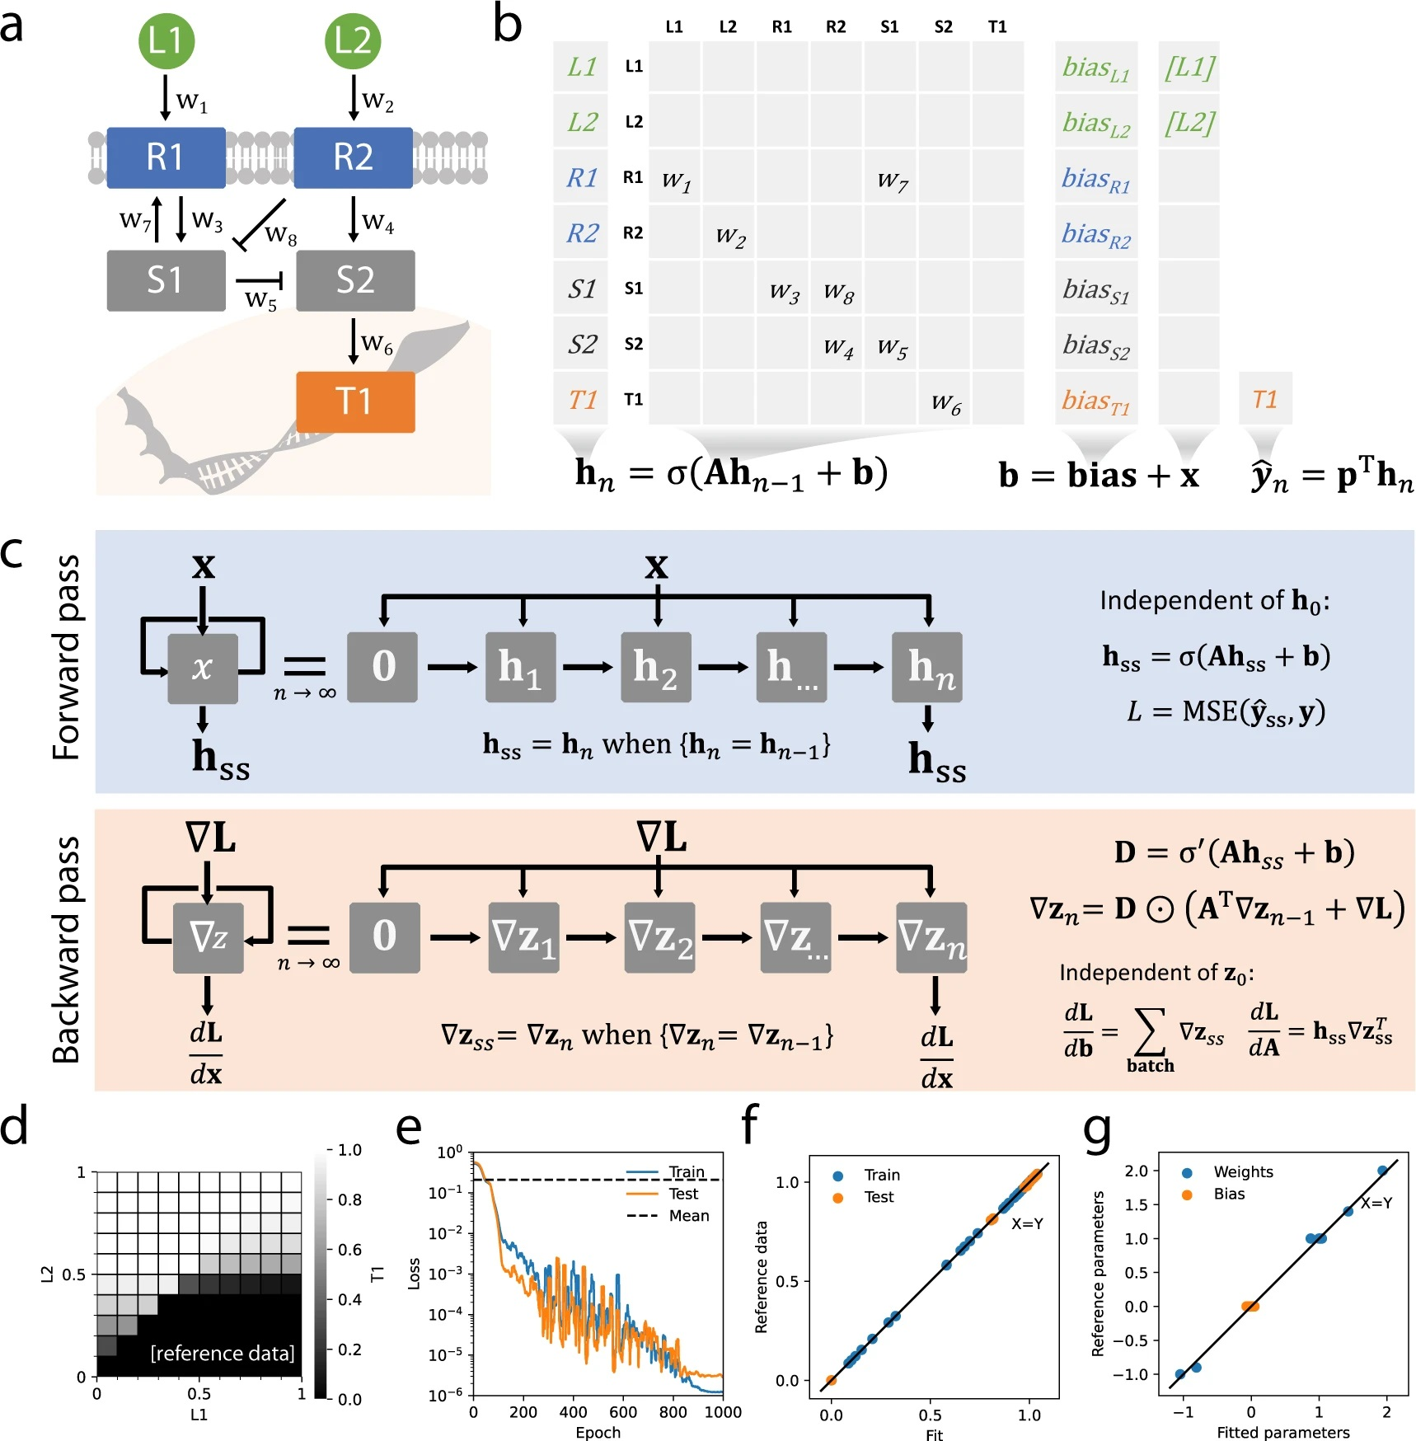

Biologically informed network, stable version
Network structure encoded in A, unknown learnable weights
The activity of each signaling node is a weighted sum of the activities of interacting nodes, which is clipped and squashed into the range 0-1
Input
Propagate until steady state
RNN
Recurrent Neural Network
Notes:
It turns out we can encode molecular networks as a recurrent neural network and use standard approaches to train predictive models. For example, this network is encoded like this. If this was a standard model, all boxes would have weights, but here we only need to learn relations between molecules that interact.
The recurrent neural networks allow signals to propagate, say from ligands to transcription factors, and it also allows for feedback loops in the network.

Slide 16
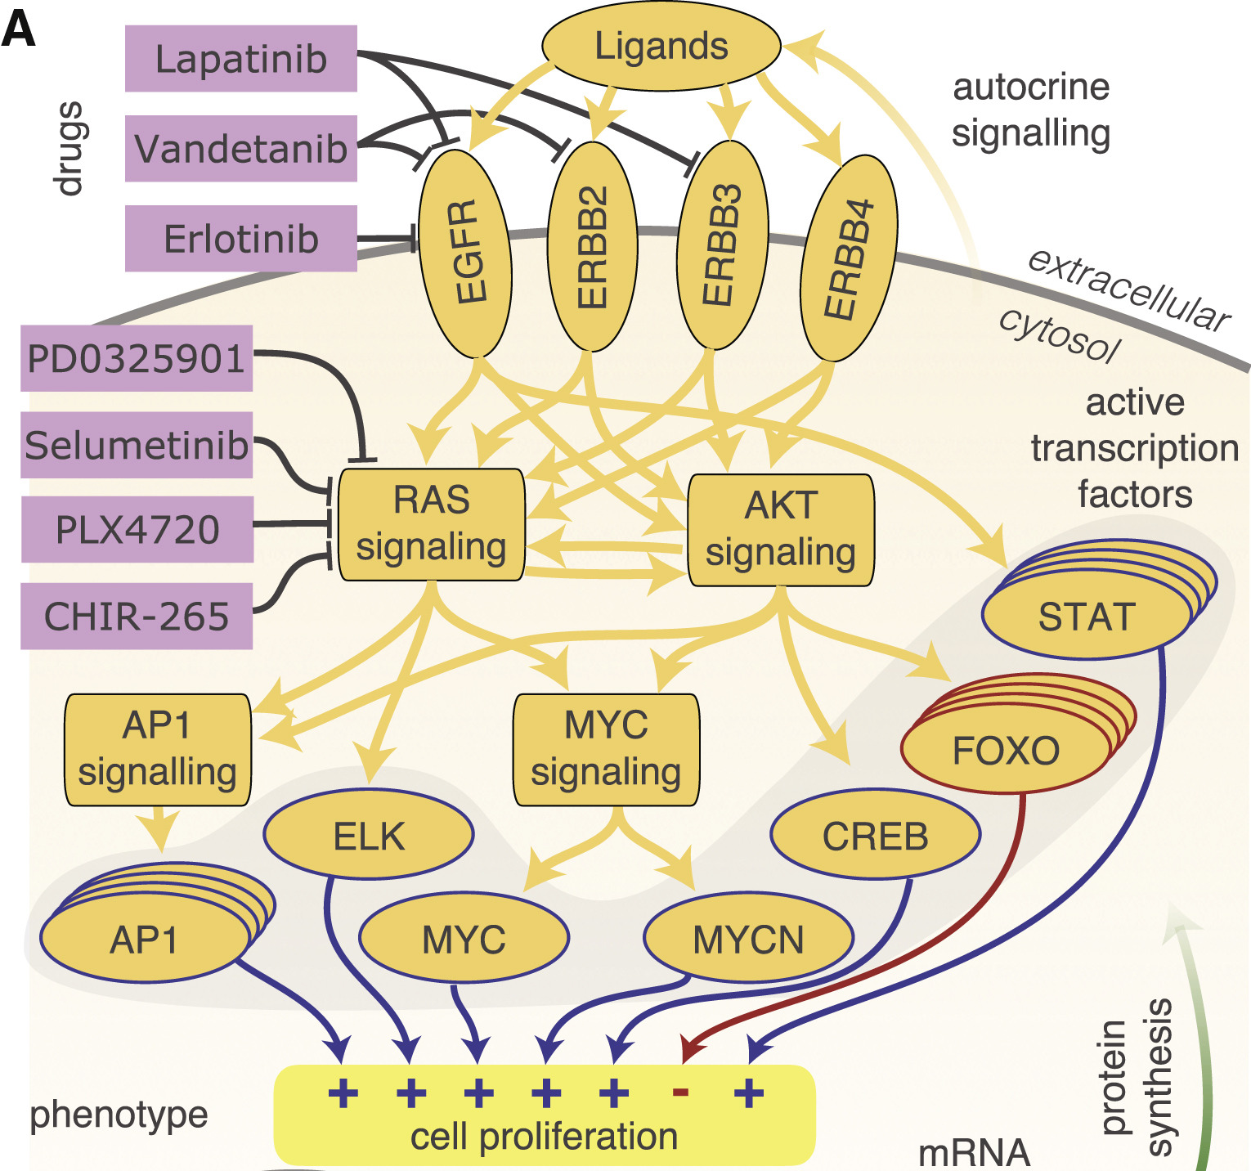
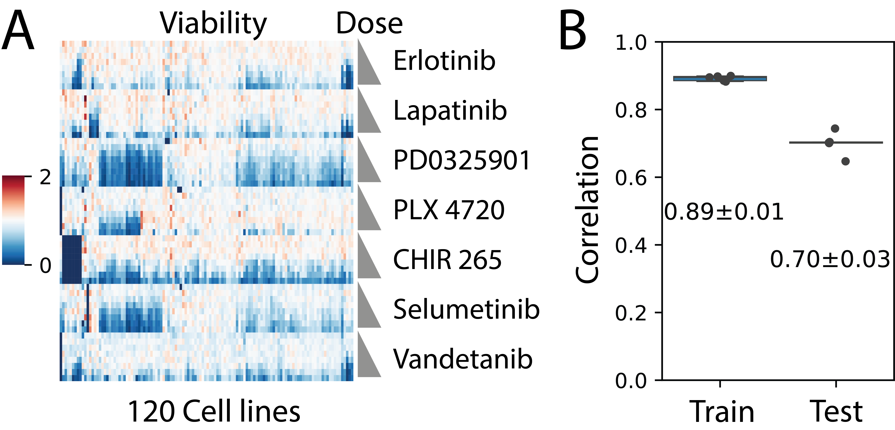
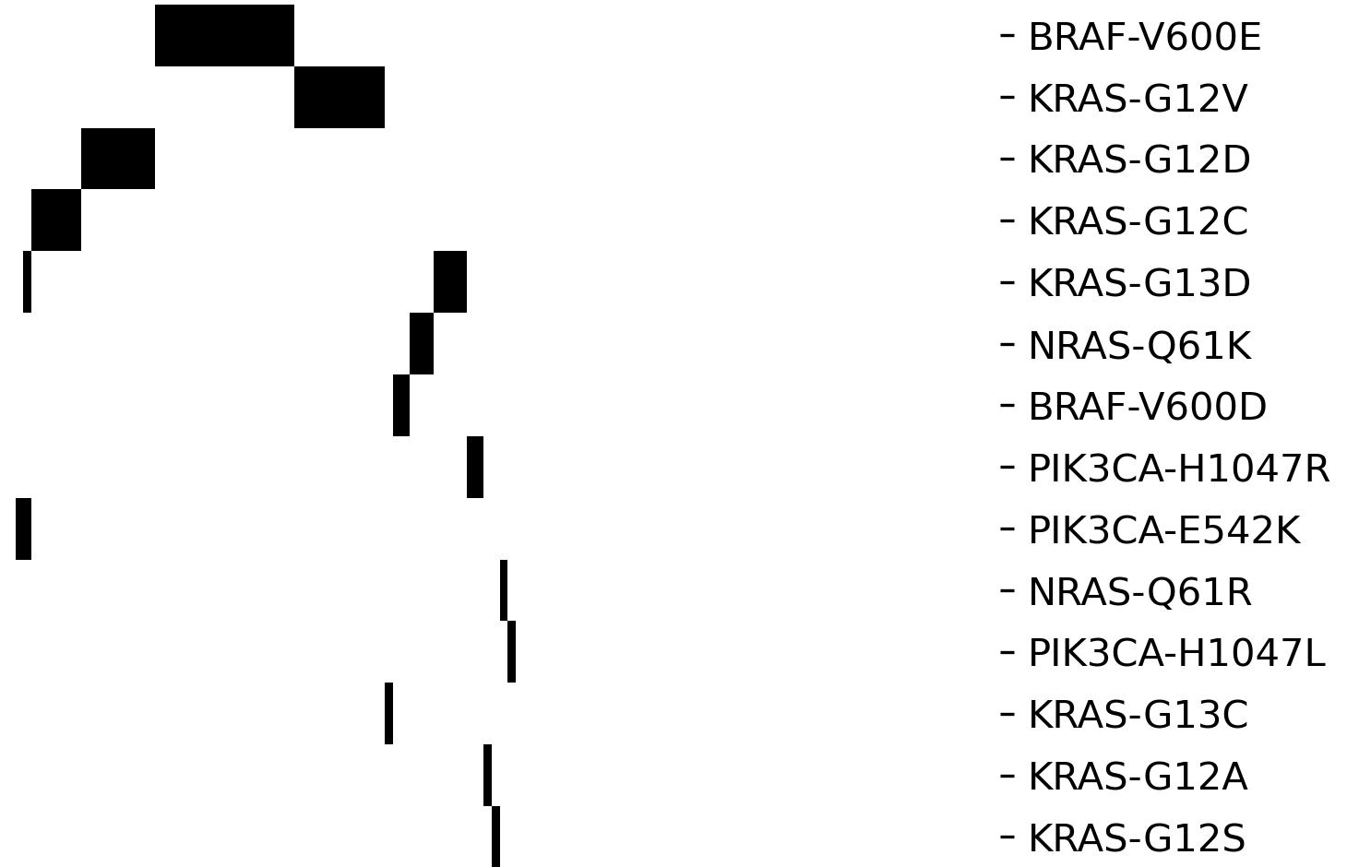
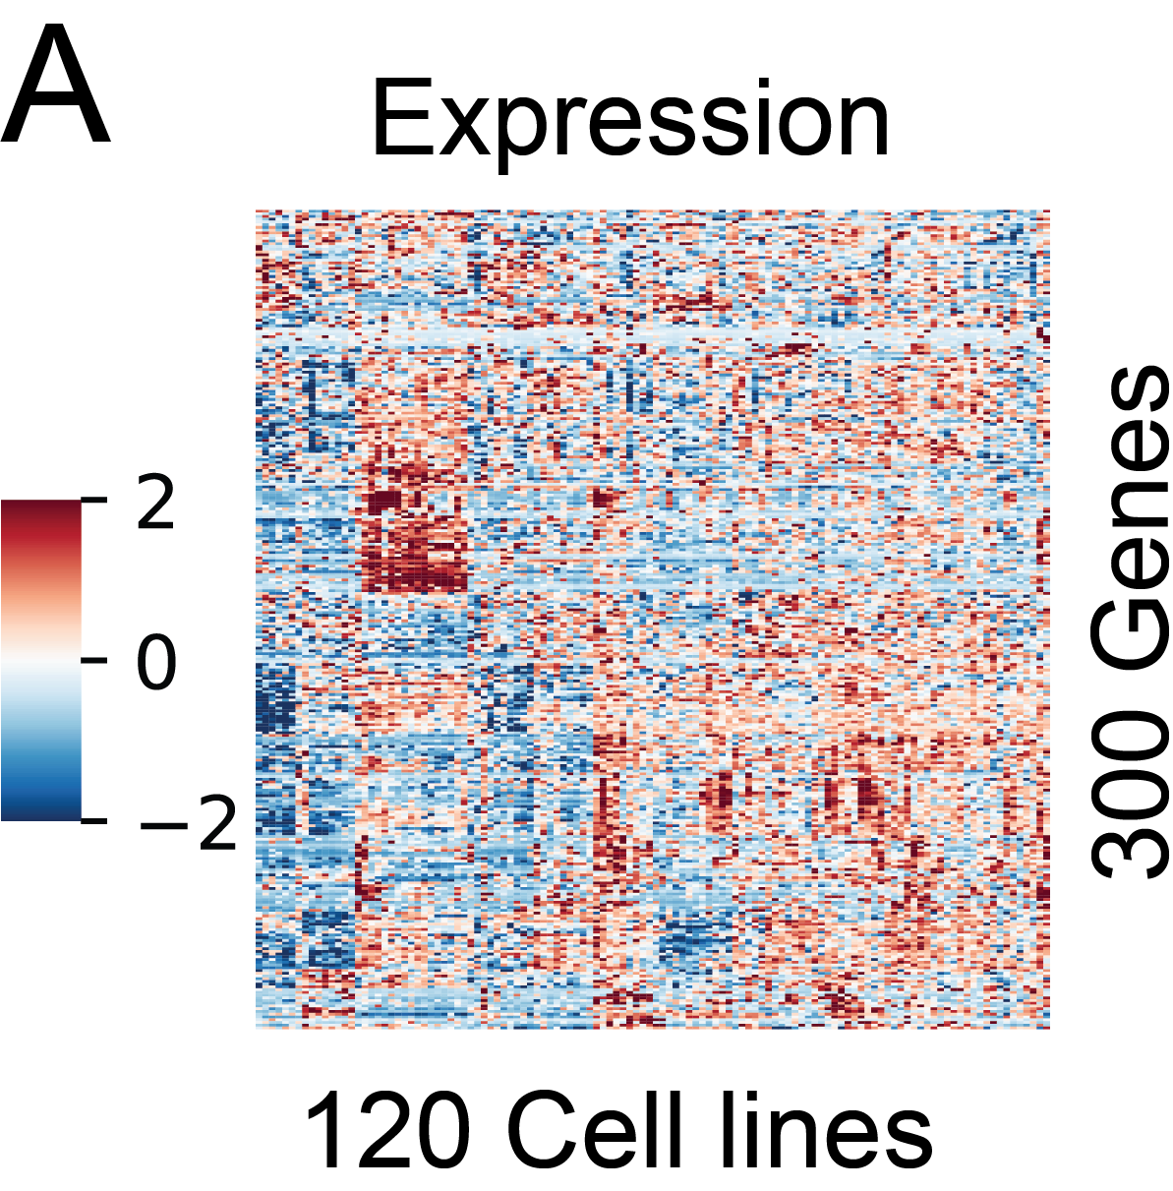
Predicting the viability effects of drugs
X_{mutations}
7 drugs
Gene expression
Viability
y
X_{drug}
X_{expression}
Fröhlich, F. et al. Efficient parameter estimation enables the prediction of drug response using a mechanistic pan-cancer pathway model. Cell Syst. 7, 567-579.e6 (2018).
Notes:
So, can we use this approach to predict viability effects of drugs? Fortunately, there is a published dataset with the viability response to 7 drugs in different conditions in 120 different cell lines with known gene expression levels and mutation profiles.

Slide 17
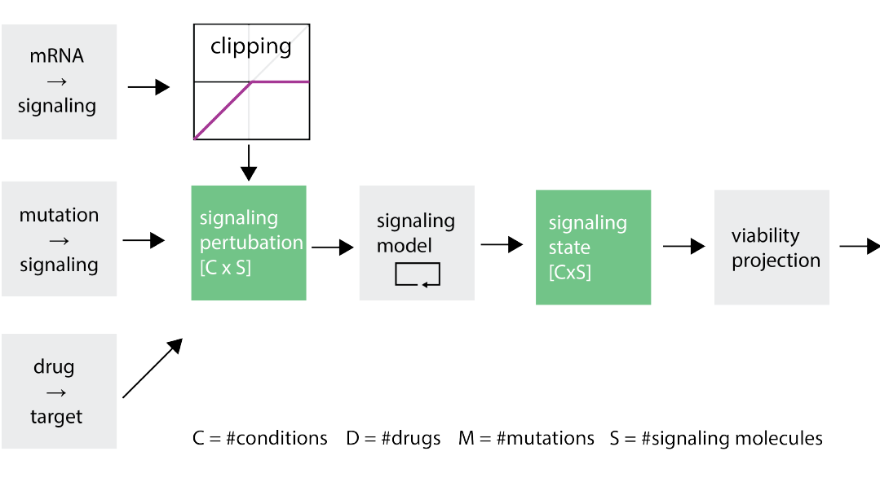


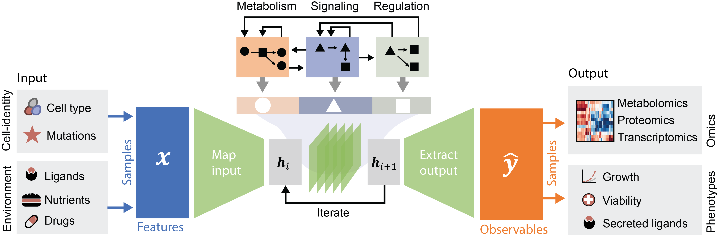


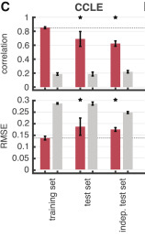
Predicting the viability effects of drugs
Mapping
input
Projecting output
Nilsson, A, et al “Artificial Neural Networks Enable Genome-Scale Simulations of Intracellular Signaling.” Nature Communications 13, no. 1 (2022): 3069.
Fröhlich, F. et al. Efficient parameter estimation enables the prediction of drug response using a mechanistic pan-cancer pathway model. Cell Syst. 7, 567-579.e6 (2018).
Train:
0.85 ± 0.01
Train
Test
ODE-based method
Our method
Test:
0.69 ± 0.09
~1 hour
~1 week
5-fold CV
ODE, ordinary differential equation
Notes:
We constructed a unified model to integrate this data.
The cell type was encoded by mapping its gene expression to the corresponding signaling proteins, mutations to their corresponding proteins and drugs to their targets.
Viability was predicted from the state of key transcription factors.
We evaluated the model’s prediction performance on cell types not used in training with 5-fold cross-validation, with good results.
This took around an hour on our laptop. For comparison, an ODE model of similar size developed by our colleagues, took them 1 week to train on a computer cluster.
While one can of cause wait for a week, the timing scales with model size, and training models faster is also useful when testing new functionalities

Slide 18
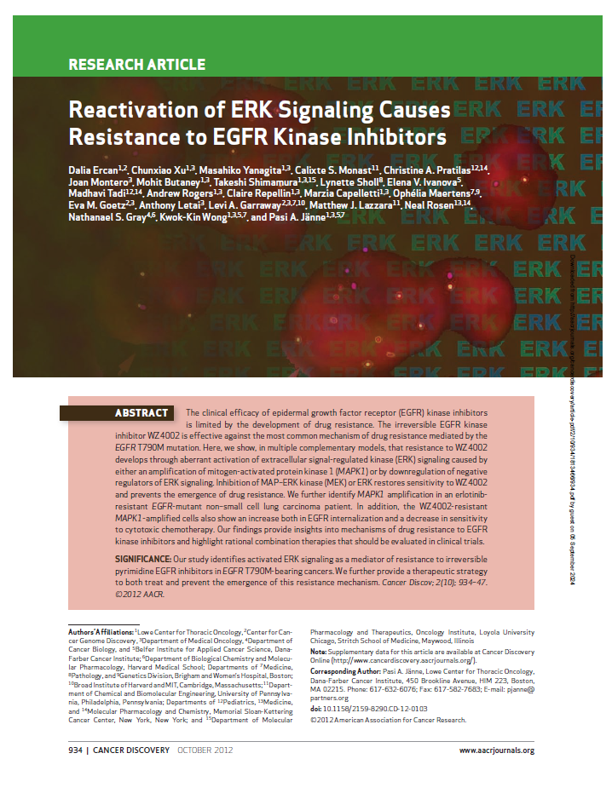
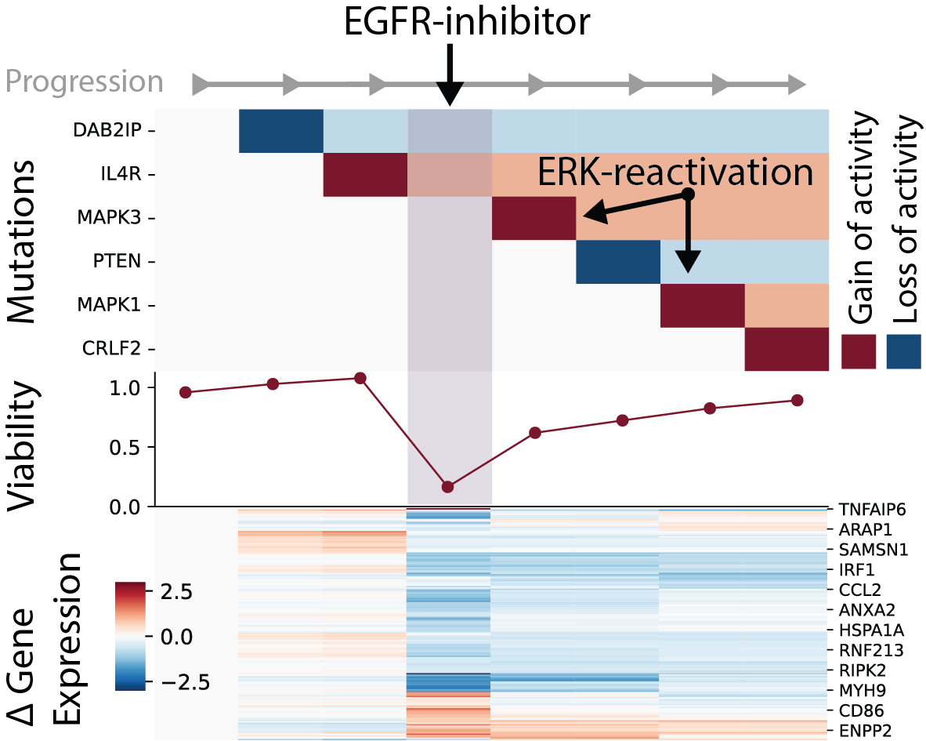
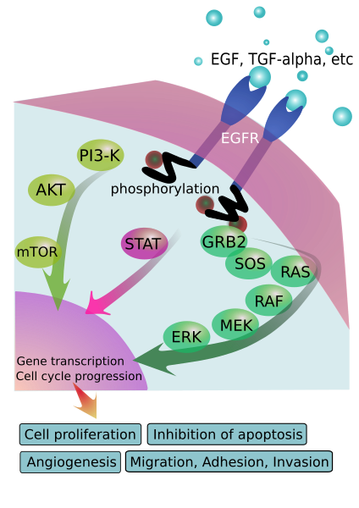
Basic simulation of cancer evolution
Unpublished results
Maximize
cancerindex.org/geneweb/EGFR.htm
Notes:
In this basic simulation Viability was maximized by brute force (fully) activating or inhibiting each signaling protein and selecting the one with maximum effect for the cancer proregression (accumulation of mutations)
This reproduces ERK reactivation in presence of EGFR inhibitors.

Slide 19



Macrophage responses to ligand patterns
Unpublished results
Bryan Bryson
Jacob Hochfelder
Josh Peters
Massachusetts Institute of Technology
Notes:
To train such a model we need data that is designed for deep learning.
Here together with my collaborators at MIT we generated information rich training data optimized for deep learning, by stimulating macrophages with ligands in high order combinations and measuring the transcriptional response.
We trained our 1 gen model, and it fits much of the data and this generalizes to unseen samples in cross validation
We then used the model to screen for synergistic effects of ligand combinations on gene expression, that we validated with an independent experiment.

Slide 20
Sanity check: internal states
Unpublished results

Slide 21
Independent validation
Unpublished results
Notes:
So this is all good, but the real purpose for constructing the model was to learn complex interactions.
We therefore simulated all pairwise ligand combinations and looked for genes with synergic expression patterns.
[Unpublished results]
And this is not an exception, as there is strong correlation between predictions and expression levels in 14 untested conditions.

Slide 22







Applied to phospho-proteomics data
Unpublished results
0-shot learning
EGF stim
Ligand/
Drug
Phospho-
sites
Signaling
Konstantinos
Antonopoulos
Phospho-sites
Fits
Time
Phospho-sites
PI3K
SHP2
Inhibitors: PI3K (LY294002)
SHP2 (SHP099)
RSK (SL0101)
MEK (U0126)
Time
RSK
MEK
Feng, S., Sanford, et al Phosphoproteomics Data Resource for Systems-level Modeling of Kinase Signaling Networks. bioRxiv 2023.08.03.551714 (2023). doi:10.1101/2023.08.03.551714
Notes:
The same approach can be extended to phospho-proteomics data.
By training the model on data from EGF stimulated cells in presence of 3 drugs, the signaling response of a 4th drug could be predicted.

Slide 23



How do we go deeper?
Goal:
Express 1000s of functions, with a single network
Olof Nordenstorm
Not feasible:
Loop over 1000s of unique networks
All of this was run with the weighted sum and non-linear transformation
Possible:
Sparse block matrix, but not GPU friendly

Slide 24
Solution: the propagator
Unpublished results

Slide 25



Synthetic dataset
Unpublished results
activity
200 samples
First order + several interaction terms
Up to 10 simultaneous inputs
100 functions
Activator
Inhibitor
Mean input level

Slide 26



Results
Train
r=0.993
Unpublished results
(Input noise in training)
Test
Mean input level
r=0.991

Slide 27

Applied to metabolism
Unpublished results
Unpublished results
Xuechun Xu

Slide 28





Muscle simulations
Unpublished results
Features
Nilsson, A., Björnson, E., Flockhart, M., Larsen, F. J. & Nielsen, J. Complex I is bypassed during high intensity exercise. Nature Communications 10, 5072 (2019).
Notes:
https://www.physio-pedia.com/Muscle_Cells_%28Myocyte%29

Slide 29


An interpretable deep learning model of the cell
Predict effects of mutations
Submodule integration
Gene regulatory timescales
Missing interactions (lack of knowledge)
Identify paths to drug resistance
Simulate cell-cell interactions

Slide 30



Now is the time for an AI model of the cell
Networks
Data
Gene Expression Omnibus (GEO)
OmniPath &
Human 1
Deep learning
Notes:
While this may sound a bit futuristic, I think that this is really the right time for an AI model of the cell, as the cellular networks are becoming completed, and we now have the hardware and methods to construct really large models, and we have the capacity to generate more data than any human can possibly analyze.

Slide 31





Acknowledgments
Avlant Nilsson
Olof Nordenstorm
Xuechun Xu
Konstantinos
Antonopoulos
Rickard Sandberg
Bryan Bryson
Josh Peters
Jacob Hochfelder
Julio Saez-Rodriguez
Attila Gabor
Pablo Rodríguez Mier
Sebastian Lobentanzer
This work was supported by the SciLifeLab & Wallenberg Data Driven Life Science Program (grant: KAW 2020.0239)
Kasper Karlsson
Janne Lehtiö
Michael Birnbaum
Caleb Perez
Thomas Helleday
Bas Teusink
Jurgen Haanstra
The lab is growing, talk with us about future projects!
avlant.nilsson@ki.se
Päivi Östling
Claus Jorgensen
Arne Lindqvist
Karolinska Institutet - a medical university
Notes:
This is the team, collaborators and funding

