Slide 1
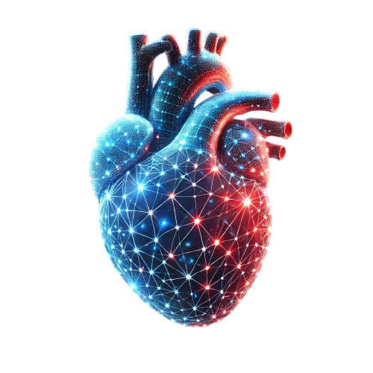
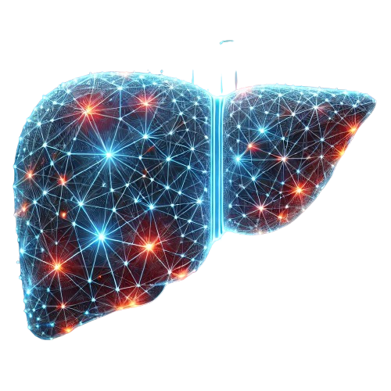
Understanding the Molecular Mechanism of Progressive Diseases An Integrative Omics Network Approach
Muhammad Arif
Assistant Professor (DDLS Fellow)
Wallenberg Laboratory, Institute of Medicine
University of Gothenburg

Slide 2
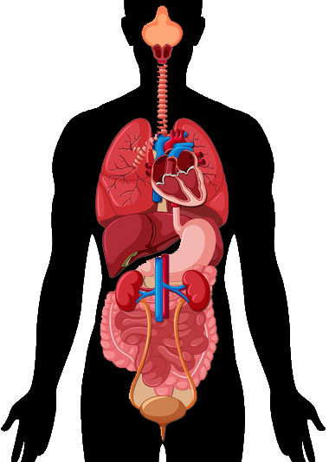
Network Biology to Map Biological Complexity
DNA
Genomics
Metabolites
Metabolomics
Interconnected!
Faulty system:
Isolated
Systemic problem
RNA
Transcriptomics
Microbiome
Metagenomics
Proteins
Proteomics
Notes:
Why network analysis? In my opinion, the network is the best representation to model a complex system. CLICK
Such as human body. Why? CLICK
Not only that they are complex, but these systems are interconnected. CLICK
And when we are talking about a faulty system, or human diseases, CLICK indeed it can be an isolated problem, but more often it is a systemic problem that affects multiple subsystems or organs CLICK

Slide 3
Network Biology to Map Biological Complexity
Relationship of analytes:
Within single omics
Between multi-omics
Cellular compartments
Tissues
Perturbation
Analysis Types:
Co-expression/abundance
Centrality
Community Detection
Distance
Notes:
These interconnectivities and crosstalks can be represented as one big biological network
Where we can study the relationship of the analytes, including ……. CLICK
But of course, the biggest question is what can we learn from the network? CLICK
We can learn about the co-expression/co-abundance of the analytes
we can identify the driver analytes associated with different perturbation of condition changes
We can identify communities/subnetworks that are involved in specific biological processes
We can even deduce the closelessness of different analytes by measuring their topological distance

Slide 4
Systemic Diseases are often Progressive
Heart failure, cancer, diabetes, kidney diseases, pulmonary fibrosis etc
. . .
Stage I
Stage II
Final Stage
Complexity of disease progression are often neglected in data-driven research
Healthy
. . .
Pre-disease
Early Disease
Late Stage

Slide 5

Catching it early!
Leo
House cat
4.5 years old
When he is looking at us like this:
Too late
The mess was already done
Damage control vs prevention

Slide 6
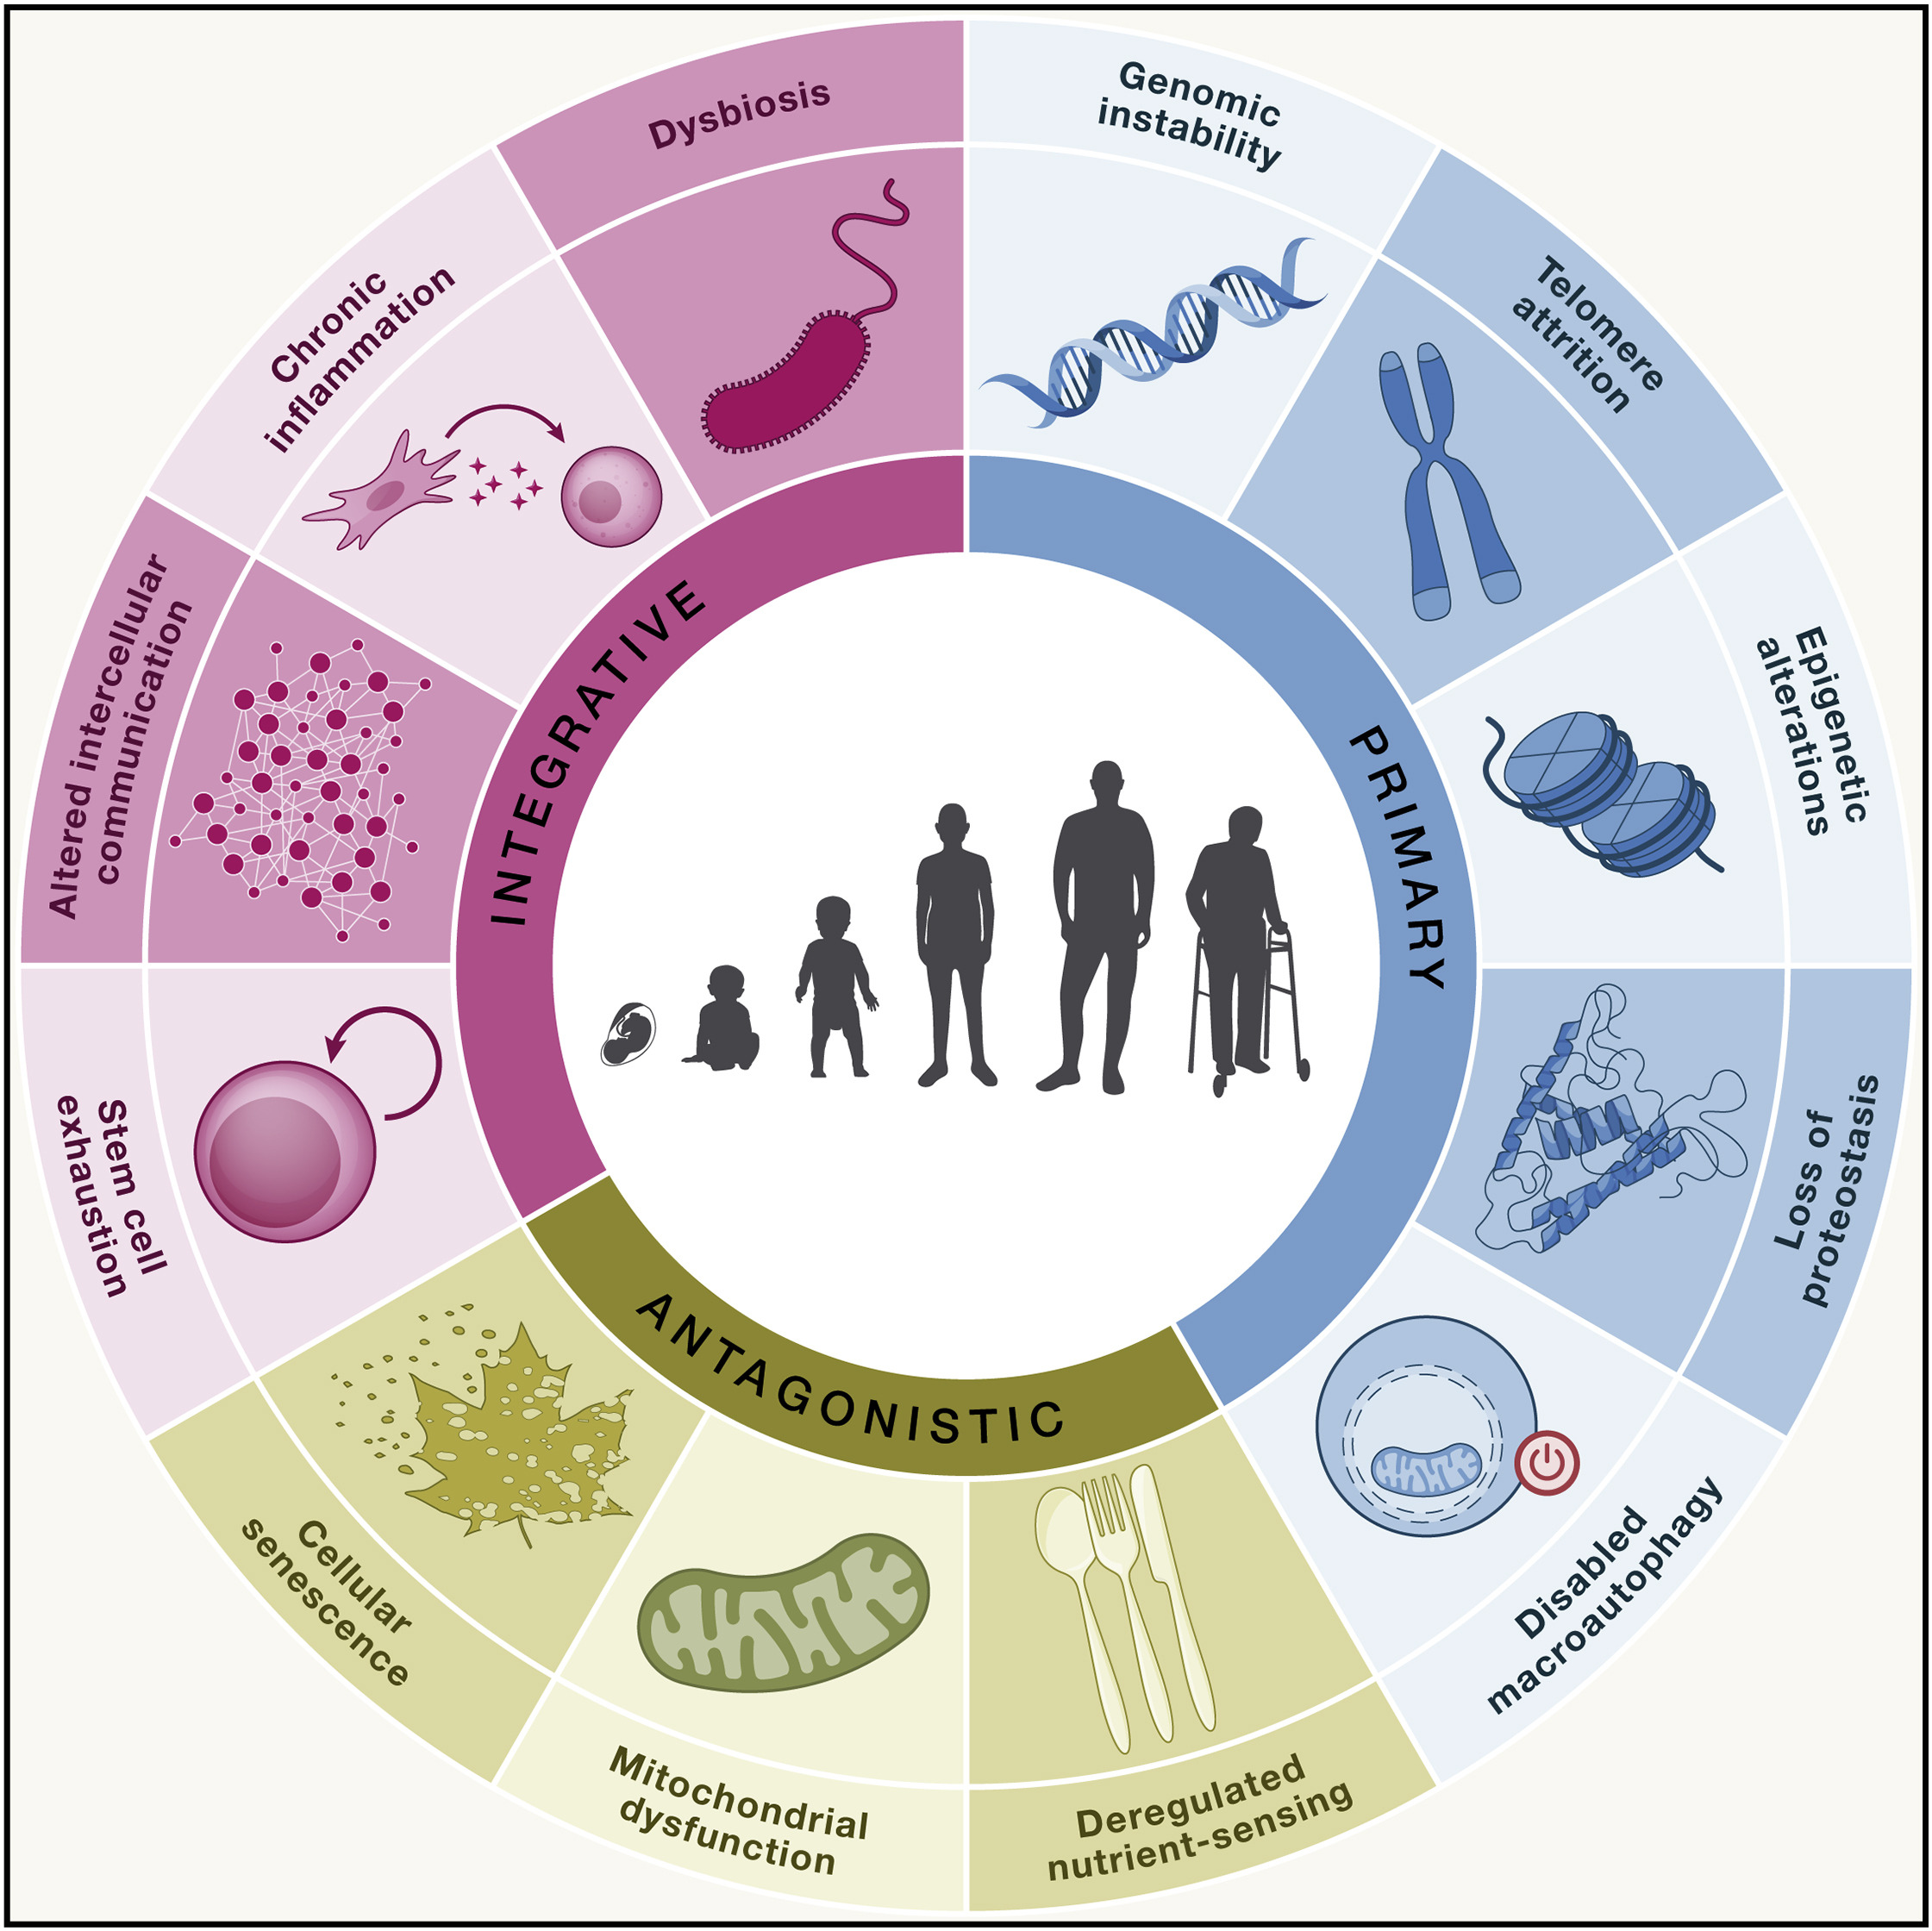
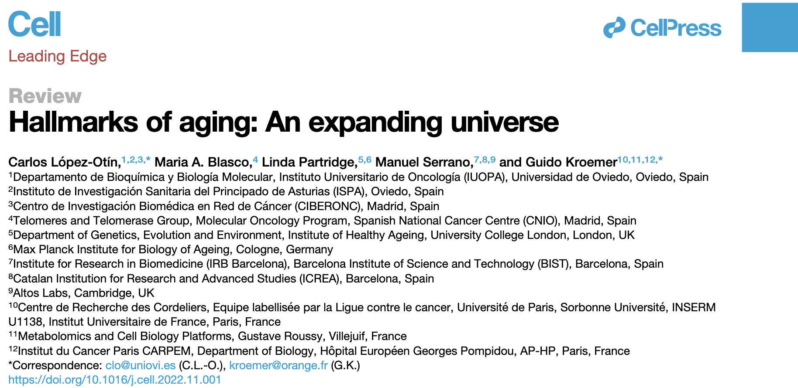
Human life is a progressive ”condition”
Aging

Slide 7
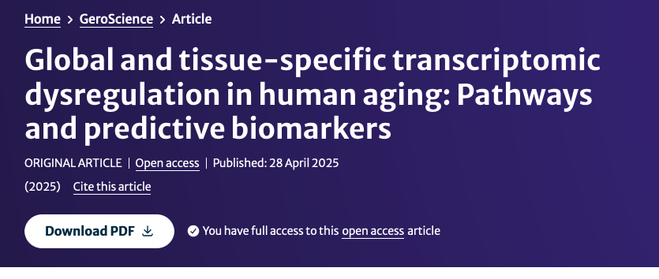
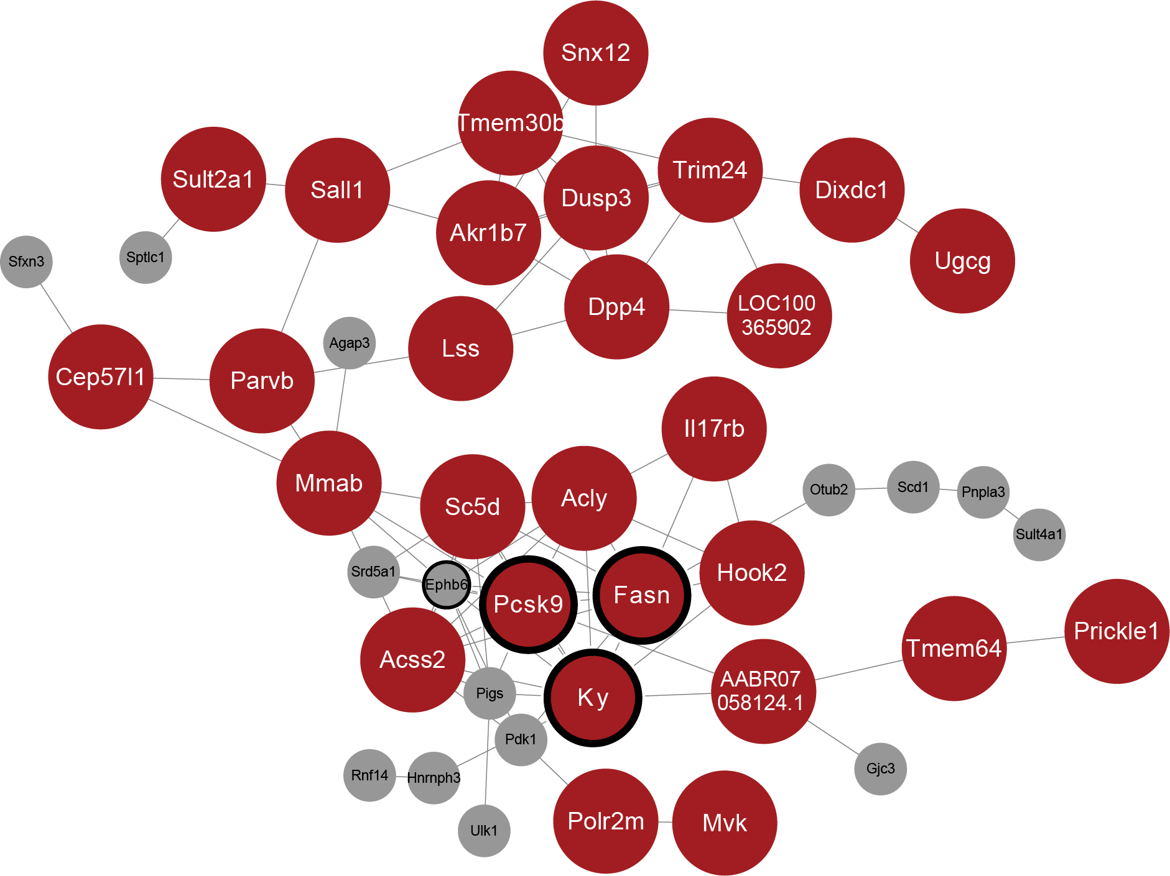
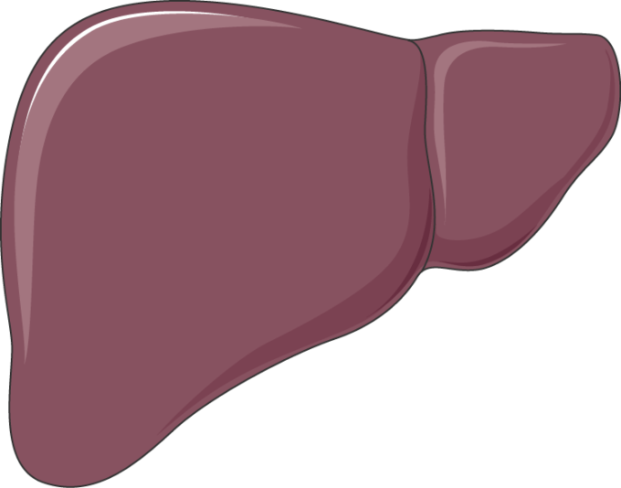
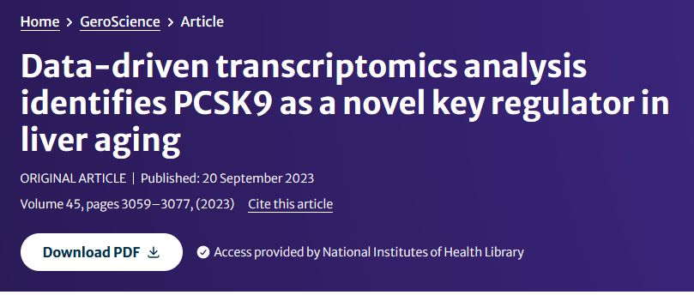
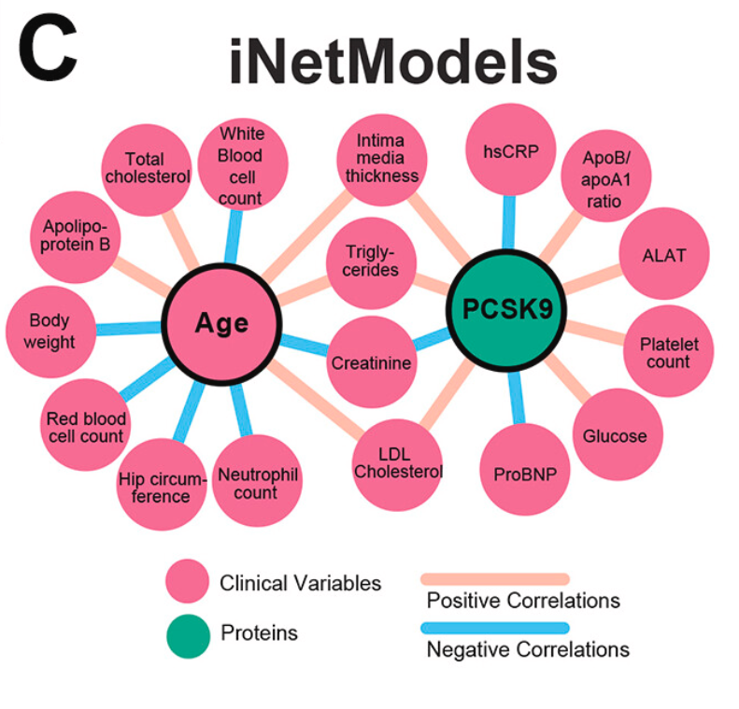
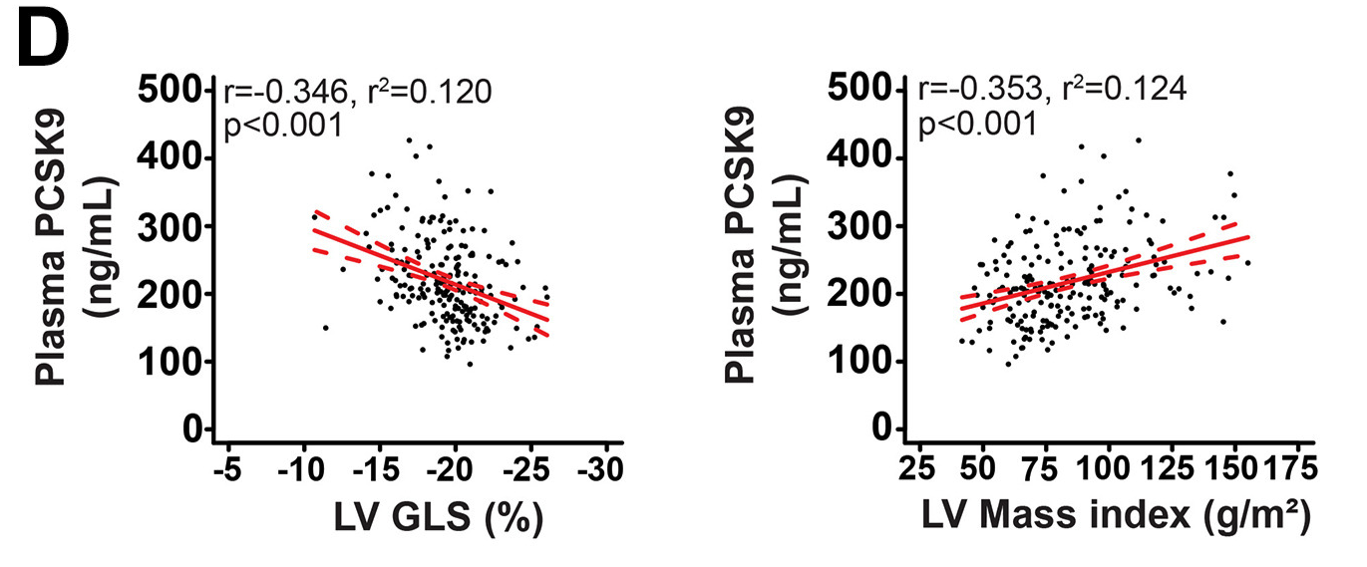
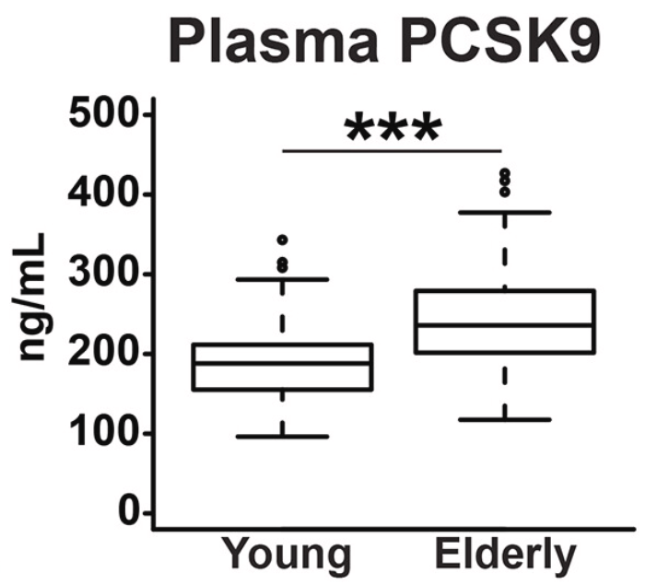
Previous Works
Cardiometabolic
Aging

Slide 8
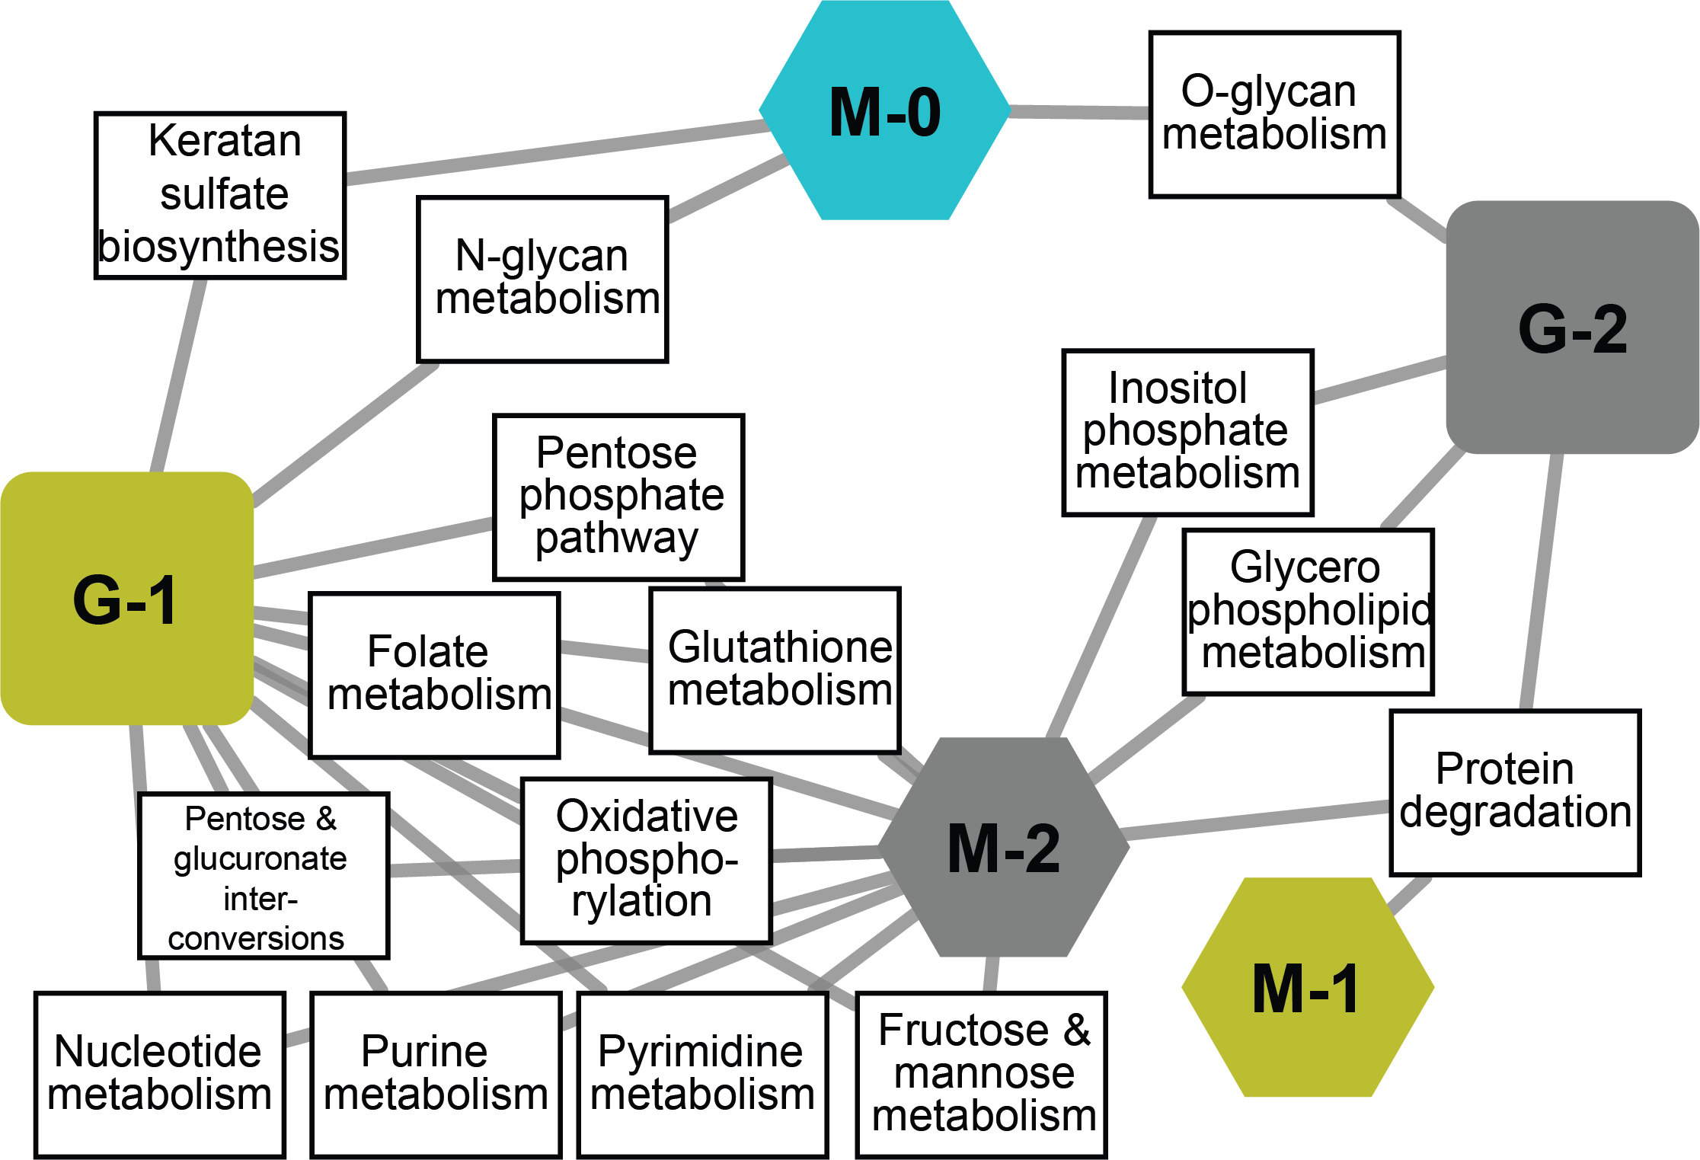
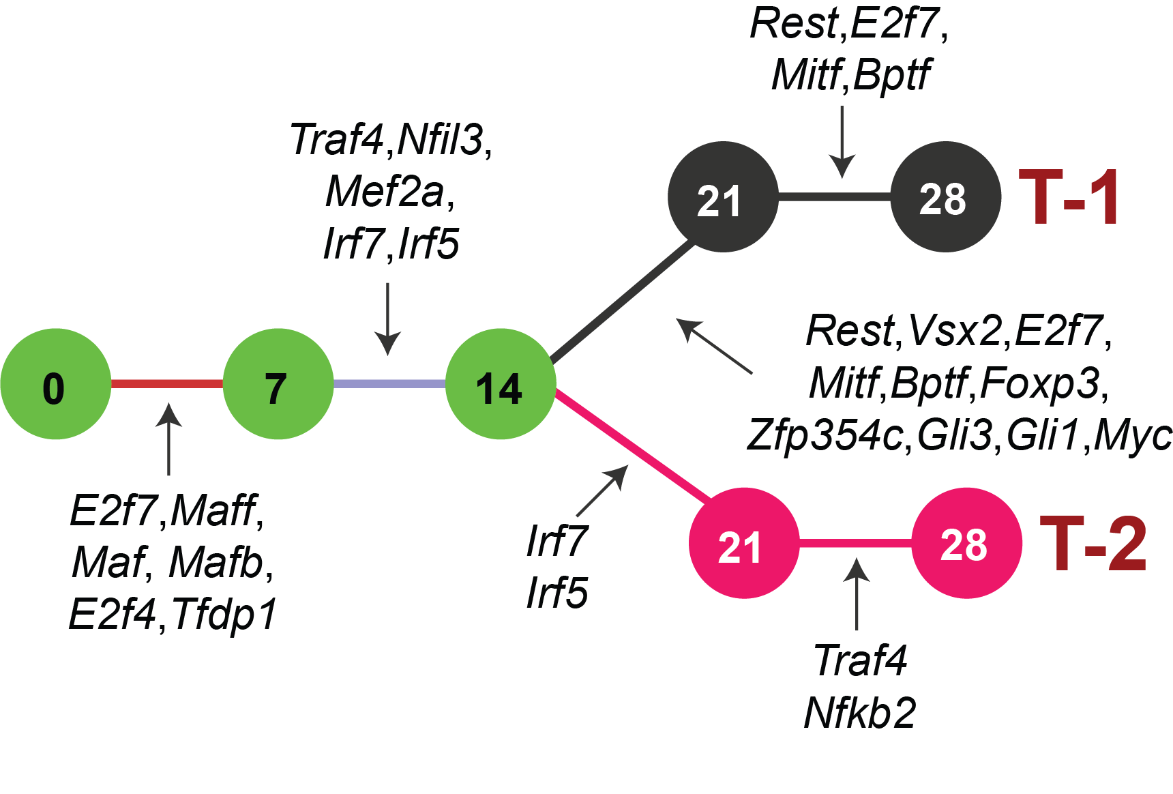
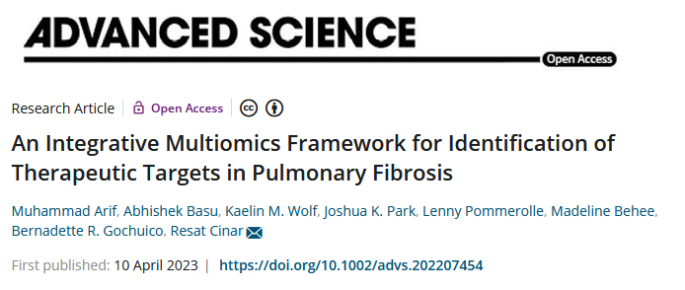
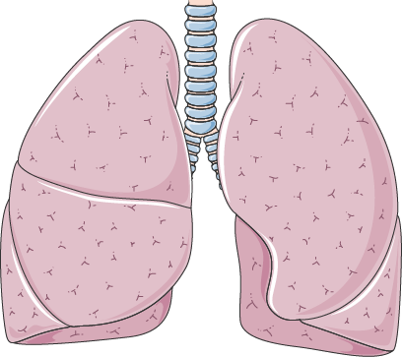
Previous Works
Multi-Omics Network
Dynamic TF Modeling
Intervention Assessment

Slide 9
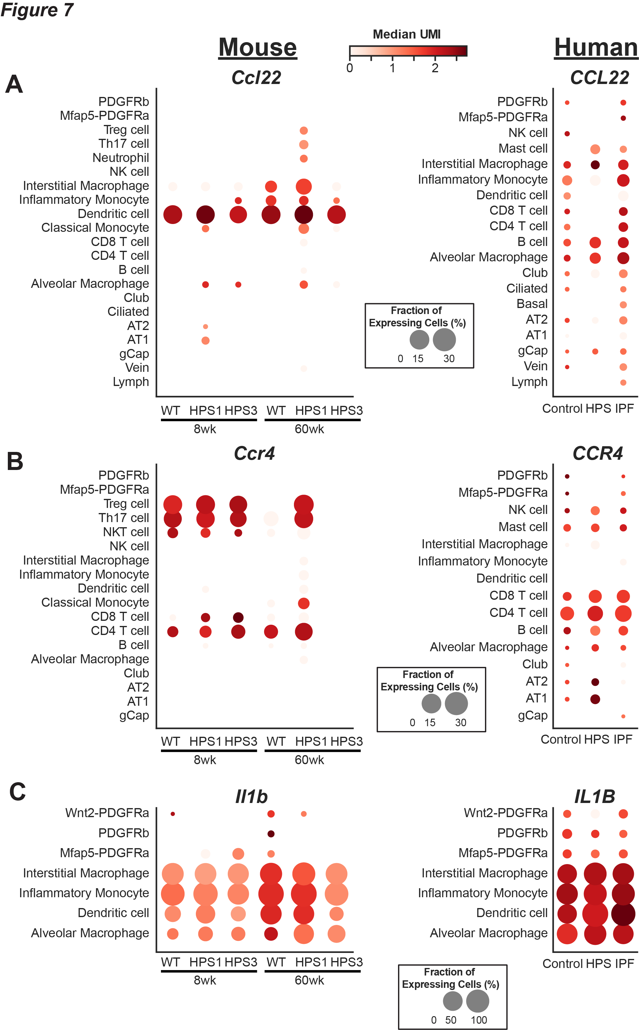
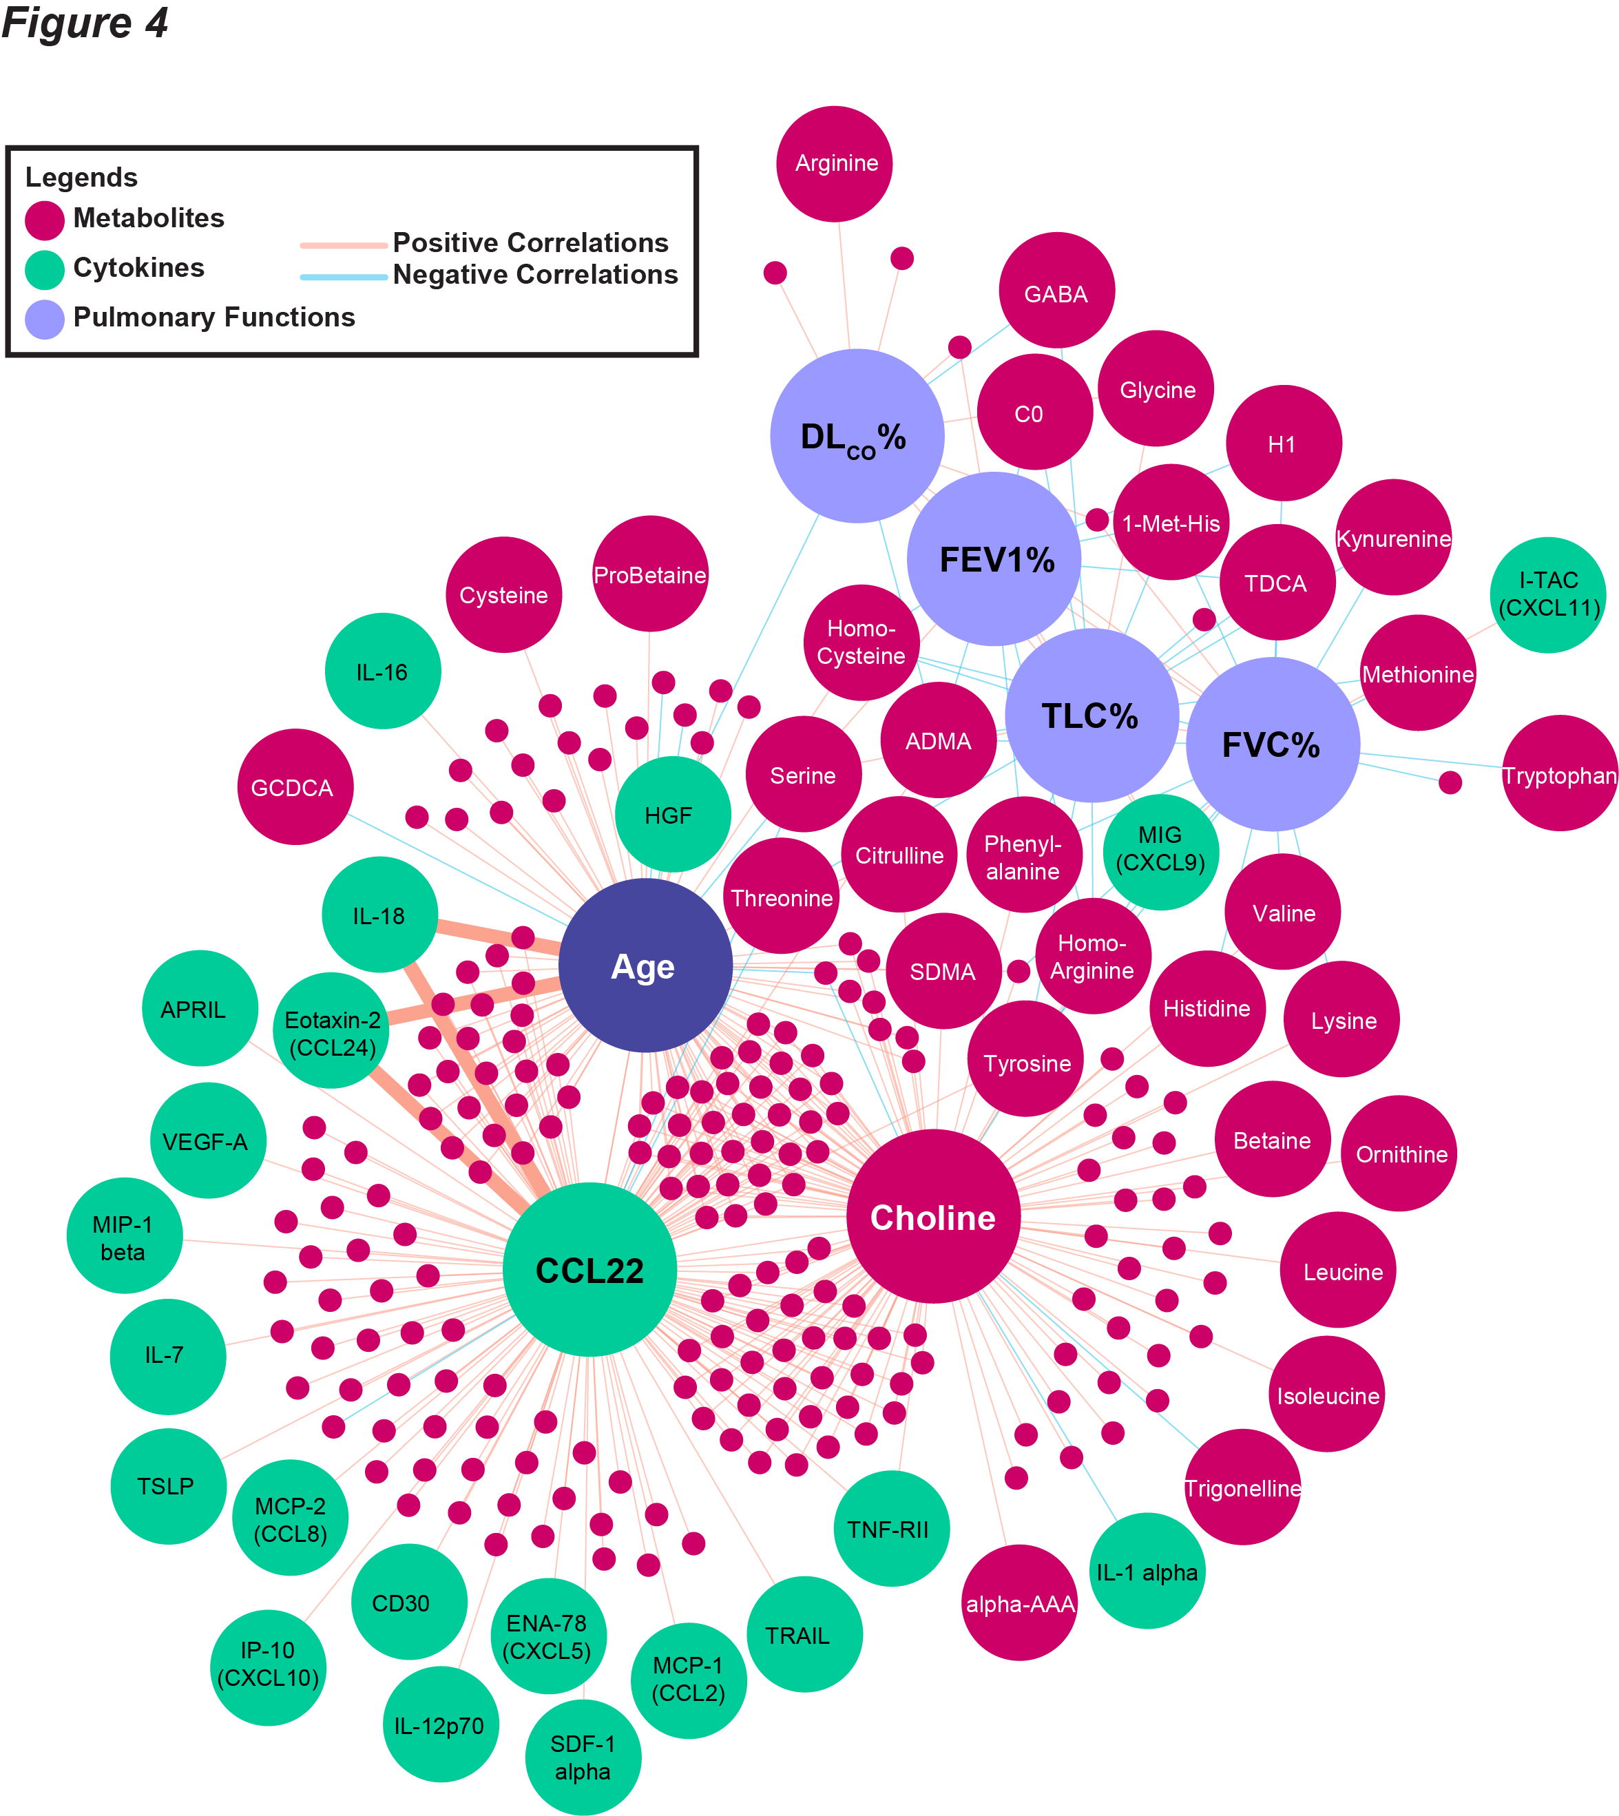
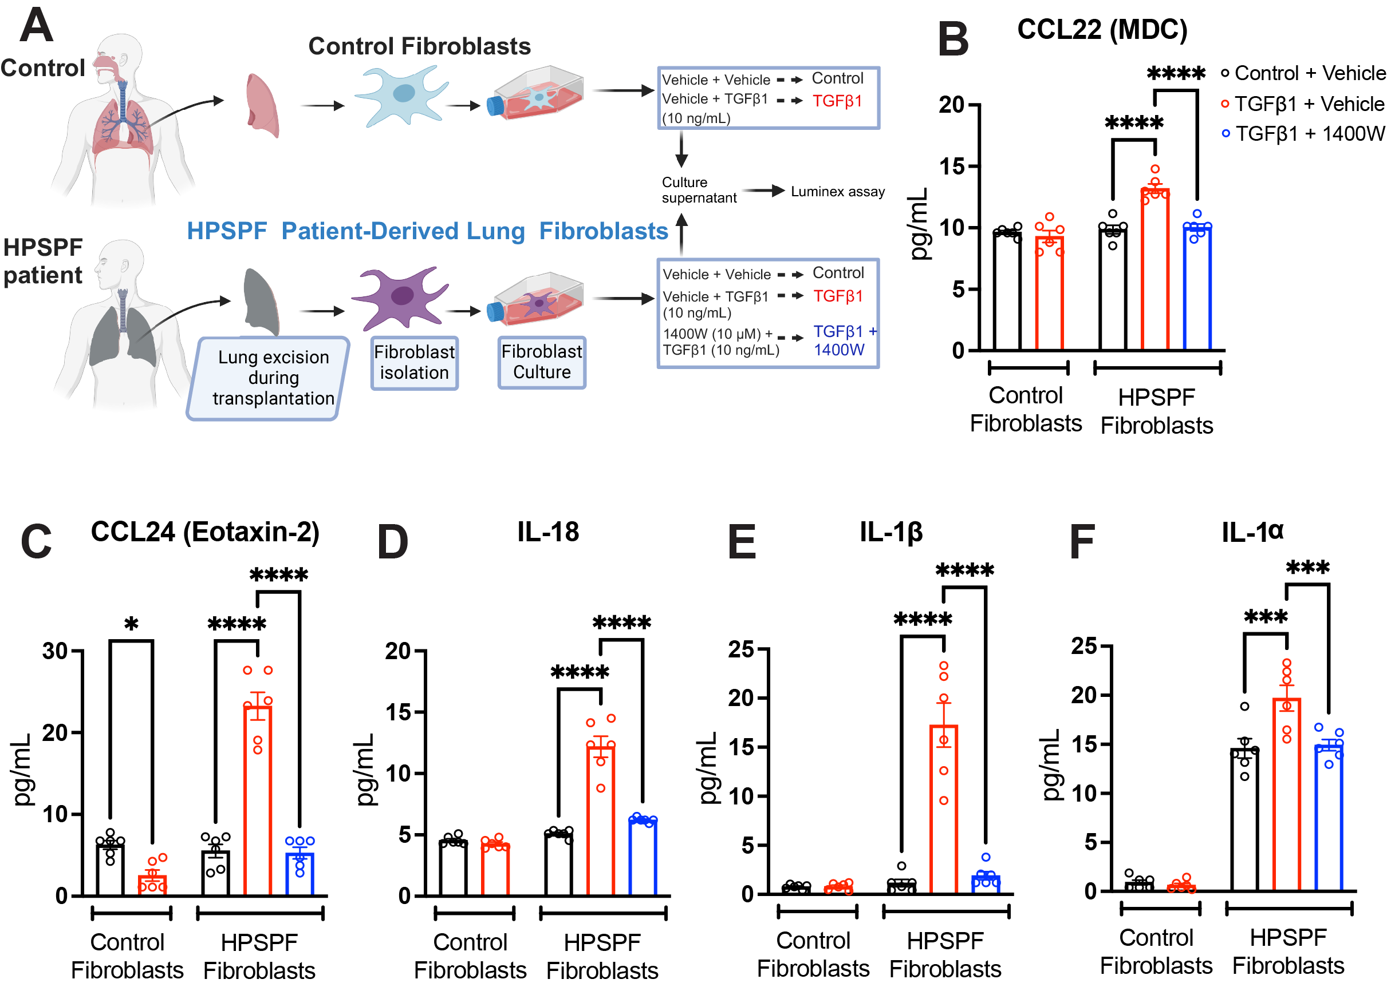
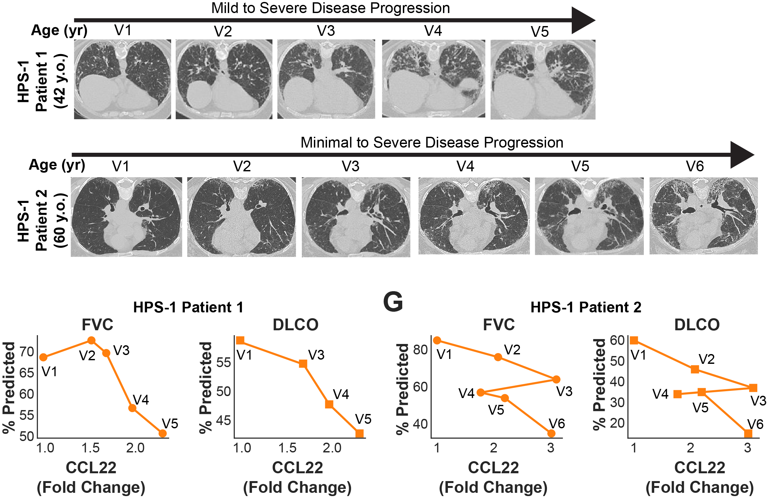
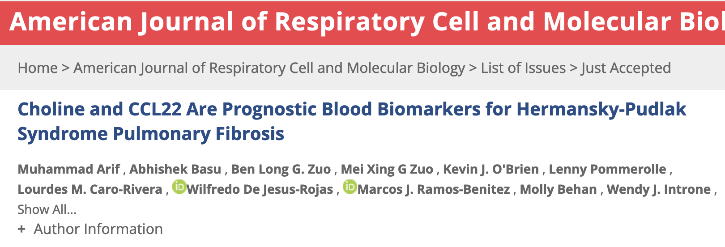
Previous Works

Slide 10
Omics Data
Biological Insight

Slide 11


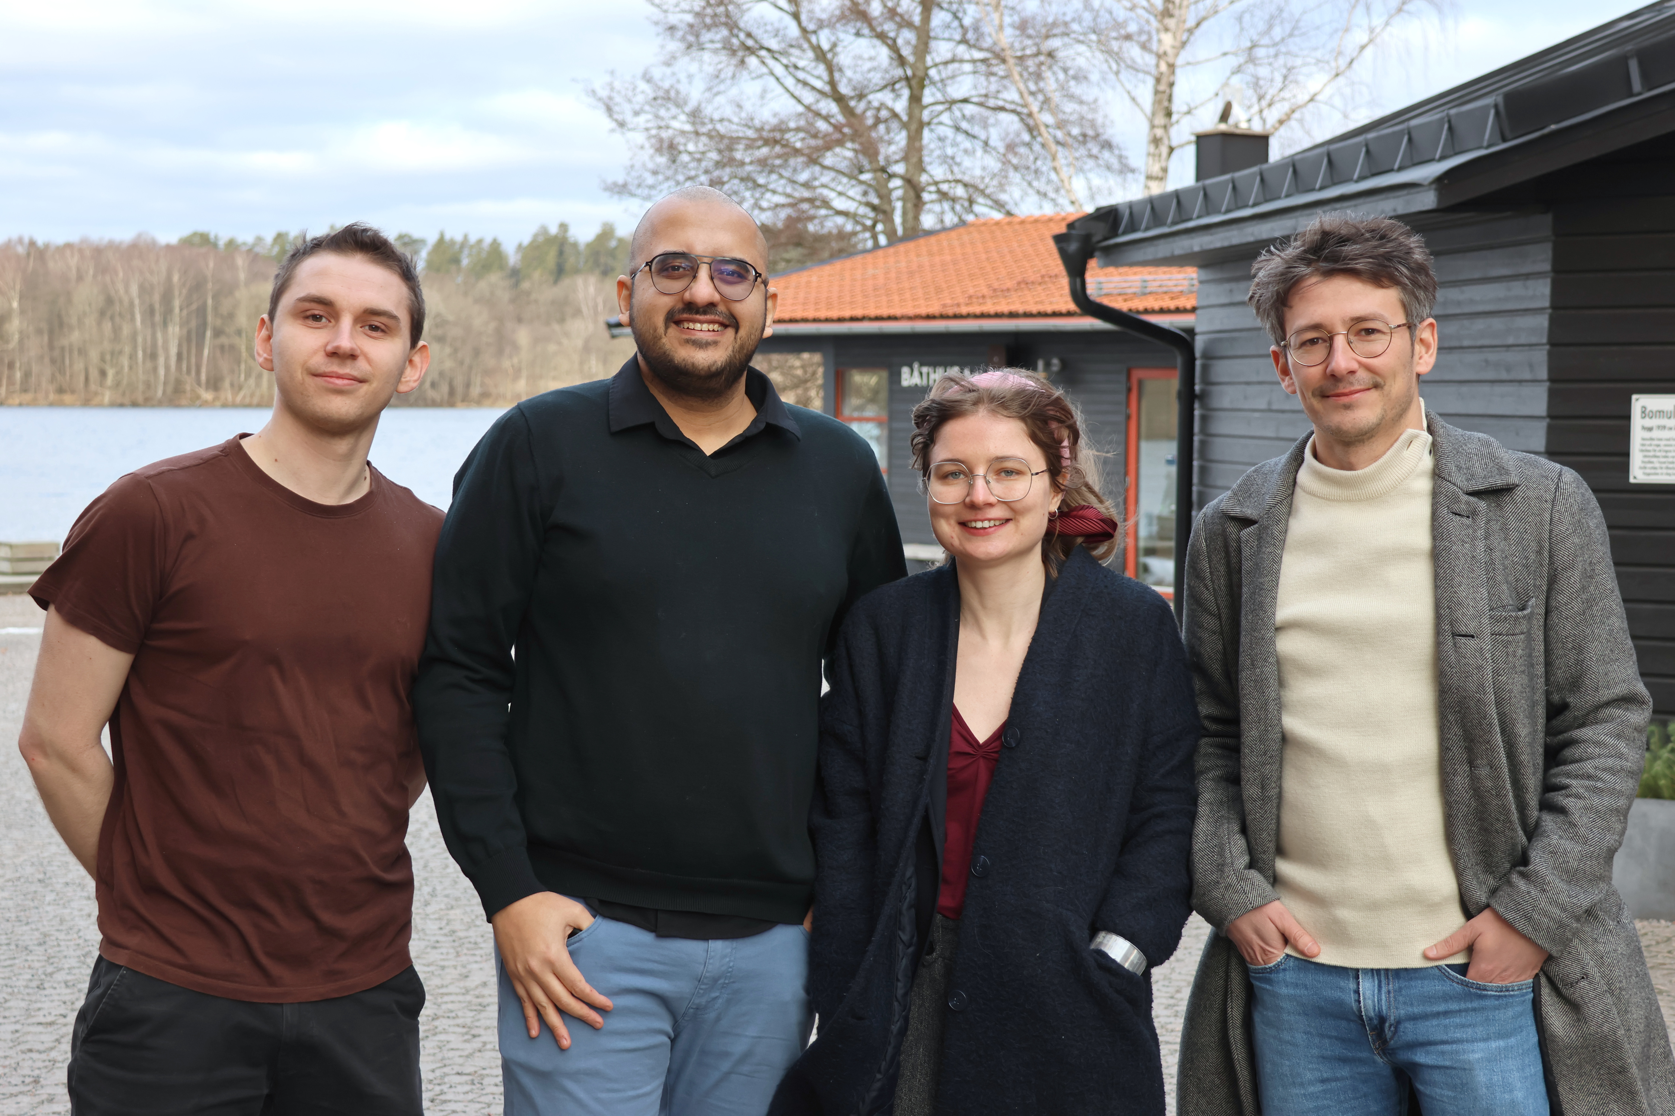




Thank you for your attention!
Amanda Olmin
Postdoc
Tom Le Corvec
Postdoc
Liam Davidsson
PhD Candidate
TBD
Postdoc
TBD
PhD Candidate
Lab: multiomics.se

Slide 12

Contact: muhammad.arif@gu.se

